Slide 1
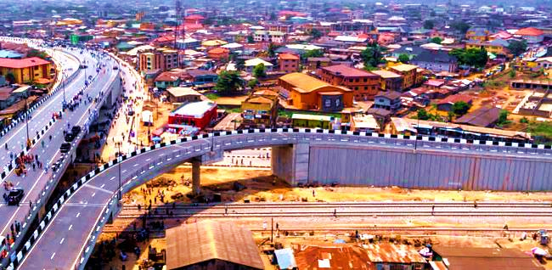


A STUDY REPORT ON THE IMPACT ASSESSMENT OF THE PEN CINEMA AGEGE FLYOVER
MEPB
Prepared by : Mrs. Akoro, E. I.
Monitoring and Evaluation Department MED/MEPB
LAGOS STATE
MINISTRY OF ECONOMIC PLANNING AND BUDGET
July, 2021

Slide 2
Table of Content
Page
Acronyms -------------- 3
Acknowledgement -------------- 4
Foreword -------------- 5
Executive Summary -------------- 6-9
Background of Study -------------- 10-11
Objective -------------- 12
Scope of Study -------------- 13
Literature Review -------------- 14
Methodology -------------- 15
Key Findings /Conclusion -------------- 16-33
Pictures during field work -------------- 34
References -------------- 35
Annexure (Questionnaire template, Data Analysis on STATA and Excel) -------------- 36-40

Slide 3
Acronyms
`BRT Bus Rapid Transport
LAWMA Lagos State Waste Maintenance Agency
LBS Lagos Bureau of Statistics
LGA Local Government Area
MED Monitoring and Evaluation Department
MEPB Ministry of Economic Planning and Budget
T.H.E.M.E.S.
QGIS Quantum Geographic Information System
STMP Strategic Transport Master Plan
Traffic Management and Transportation, Health and Environment, Education and Technology, Making Lagos a 21st Century Economy. Entertainment and Tourism, Security and Governance

Slide 4
Acknowledgement
A special appreciation to the Management of the Ministry of Economic Planning and Budget (MEPB) for their continuous support throughout the impact assessment of the newly constructed Agege Pen Cinema Flyover Bridge.
Worthy of mentioning is the Honourable Commissioner Mr. Samuel Avwerosuo Egube, who aided the success of this study in his best. He is keenly interested in the success of the State to achieve her T.H.E.M.E.S Agenda as well as Department to deliver its mandate.
We are grateful for the unflinching support of the Special Adviser to the Governor on Economic Planning and Budget, Aare Bayo Sodade who ceaselessly ensure we are in order
Words cannot express how grateful we are to our amiable Permanent Secretary, Mrs. Adetutu Abiola Liadi, for her selfless support and continuous guidance.
We also appreciate the entire staff of Monitoring and Evaluation Department (MED) and members of the public for their cooperation.

Slide 5
Foreword
Over decades, Agege is known to be one of the busiest locations and for its perennial gridlock in Lagos State. Hence, it is essential to ensure that the corridor is viable for the smooth running of a business and the implementation of physical development.
There is no gainsaying the fact that the existing road infrastructure is overwhelmed with uncontrolled influx of citizens from virtually all States of Nigeria coupled with migrants from other countries.
Conducting impact assessment on the newly constructed flyover bridge in Pen Cinema area of Agege contributory to smooth road movement is timely.
This study is a feedback mechanism in making the government aware of the impact of the flyover bridge. Moreover, the perspectives of public particularly those living and plying the route were captured.
In addition, the intersections that are thriving were also highlighted. Furthermore, persuasive actions that needed to be taken to consideration were also mentioned.
Conclusively, the study has shown that the flyover bridge have impacted vehicular movement in and out of Agege and its environs, reduced loss of man hour, improved the socio-economic activities in the corridor and greatly facelifted the Agege Pen Cinema corridor and environ.
Mrs. Akoro, E. I
Director, Monitoring and Evaluation
Ministry of Economic Planning and Budget

Slide 6





Objective
MEPB through MED which is statutorily saddled with the responsibility of evaluating State Government, programmes and projects interventions on the citizen, conducted an immediate impact assessment study on the newly constructed flyover bridge in Agege Pen Cinema area of Lagos.
The purpose of this evaluation exercise was to assess the immediate impact of the newly installed Agege Pen Cinema flyover bridge on the citizenry and serve as feedback to the Government on where we are, what to be done and how it can be more impactful.
The 5 study areas:
Iju Road off Iju Garage/Boluke Pharmacy,
Pen Cinema Under Bridge towards Mosalasi Alhaja,
Railway Police Station/Old NITEL/Abattoir Road,
Ijaiye Estate Entrance along Oba Ogunji, and
Oke-Koto/Agunbiade/Iyana Ipaja Road
Executive Summary
The study captured feedback from citizens living and plying the corridor.
A random sample size of 376 was selected to serve a good representative of the population under study.
A questionnaire was designed and categorized into offline and online groups.
Five (5) teams covered 5 clustered locations closest to the flyover bridge.
There was morning, afternoon and evening coverage for a period of two (2) weeks.

Slide 7


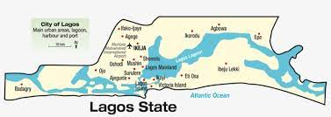
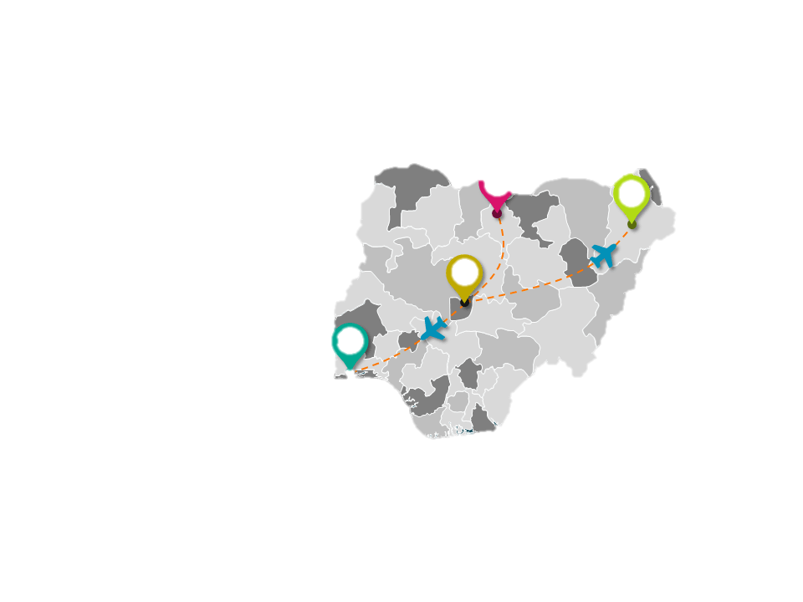


Demographic findings
MALE
FEMALE
24.4%
LAGOS STATE
67%
Executive Summary 2
33%
75.3%
OTHER STATES
FORMAL EDUCATION
94.9%

Slide 8







Summary of findings
86% of respondents said travel time has reduced by an average of 30mins.
97% claimed the loss of manhour has reduced.
77% confirmed that the rate of traffic is better and travel time is now very fast.
Average of 86% claimed that road furniture's and traffic light are sufficient along the axis
85% agreed that doing business along the Agege corridor is now made easier, while 81% improved in commercial activities along the axis.
Executive Summary 3
97% reported positive impact of traffic managers.
86.3% agreed that there was great reduction in accident rate due to the road signs.
80% claimed that there was great increase in value of properties and house rent within that axis.
Despite all the positive report 43% claimed that the project has not reduced crime rate in the axis.

Slide 9






Recommendations/Feedback
01
The open space under the bridge could either be beautified or use for motor/car park to generate revenue for the State and to improve law and order.
02
It was reported that hoodlums attack people during the day and break into shops at night, therefore police surveillance and cameras should be put in place.
Executive Summary 4
The road intersection at oke-koto is too narrow, there is need for expansion to avoid accidents.
03
There should be ban of commercial and mechanic activities on the walkway, hence enforcement officers should be on ground to caution offenders.
04
05
Environmental sanitation should be enforced in that axis and regular maintenance to avoid flood especially at Oke-koto.

Slide 10
Background of the Study
In recent years, increasing congestion on urban roads has directed attention to the development of more sustainable forms of transportation. The fact that efficient transportation systems serve as catalyst for sound land use planning and diversifying each form of transportation is increasingly being recognized. Both reasons have provided an opportunity for road transport to play more significant role in urban mobility schemes.
The improvement and rehabilitation of road transport in Lagos has the potential to help address the serious gridlock experienced in movement of people, goods and services and its associated problems such as extended travel time, loss of man hour, overcrowding and negative effects on the environment and human health.
Area of the study
The study area is Agege Pen Cinema. It is a densely populated area, aside from being a major road and rail transport terminus in Lagos. The newly constructed flyover bridge connects Oba Ogunji Road where it takes off with Agunbiade on the other side, also has a railway underpass and three abatements splitting into adjoining streets all around the axis.
The population of the area is projected at 1,507,591 in 2018 with population density at 88,682 – Abstract of LGA Statistics, LBS(2019), also with a land mass of about 17 Square Kilometer.

Slide 11
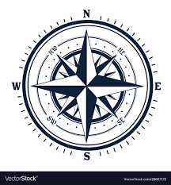
Background of the Study 2
Agege is a suburb and local government area found in the city of Lagos located in the Southwestern parts of Nigeria. The local government is made up of districts which include Ogba, Oniwaya, Dopemu, Mangoro and Sango. Agege lies in 6⁰ 36’ 55.282” N and 3⁰ 19’ 25.615” E of Lagos.
The boundary of Agege
From the Northern part of Lagos stretches from Dopemu road through Anuoluwapo street to Olukosi down Fagbola through Osobu street to Orile road down to Old Agege Motor Road opposite NITEL.
From the southern part, it stretches from Ashade retail market to Akilo street.
From the east, from Oba ogunji road up to the by-pass to Agege Motor road by NITEL office.
From the west, the boundary of Agege stretches from Abeokuta express road from boundary with Ikeja Local government to Dopemu junction.

Slide 12
Objective of the study
The purpose of this evaluation exercise is to assess the immediate impact of the newly installed Agege Pen Cinema flyover bridge on the citizenry and serve as feedback to the Government on where we are, what to be done and how it can be more impactful. Five (5) essential objectives were identified which are as stated below:
1
2
To examine the traffic management structure available along Agege corridor and other intersections.
3
To examine the effectiveness of the road furniture in place to ensure safety of lives and property.
To determine the immediate impact of the flyover bridge in addressing the perennial gridlock associated with the axis.
4
5
To provide feedback on the intervention for informed policy and future decisions.
To examine the socio-economic and physical development brought about by the completion of the flyover bridge to the people living in the area.

Slide 13
Scope of the study
The scope of study for the newly constructed flyover bridge in providing a better riding surface to road transport system in Agege was captured through the three hundred and seventy-six respondent (376) living or plying the Agege Pen Cinema corridor. The capturing was done both early in the mornings and evenings.
A Departmental meeting was held, and it was agreed that three hundred and seventy-six (376) respondents should be interviewed.
Questions capable to measuring up the objective of the study were prepared, reviewed and printed. The survey is mainly to keep abreast of the impacts of the newly constructed flyover bridge and proffer possible way forward.
Data were obtained from 376 respondents at different designed locations using structured questionnaires administered offline and online (Surveyplanet was used) . Questions were set based on objectives of the study. The study took about 2 weeks to complete.
The team consist of 3 Coordinators, 5 Supervisors and 30 enumerators. Questionnaires were administered, data was collected and submitted to the desk officers (3 Officers) where the data were keyed in and retrieved.

Slide 14
Literature Review
Lagos, one of the densely populated state and commercial capital of Nigeria has been observed to be a busy state where people across the world find interesting to live and work.
The existing road transport facilities are inadequate in meeting movement demands both in terms of size and access to commuters.
It is noteworthy to acknowledge the State Government 30-year Transportation Improvement Plan of integrating the Bus Rapid Transit (BRT) with light rail schemes and other measures in solving congestion problem.
Thus, the incorporation of bridge may cover more in terms of land use in road network system.
The current administration upon assuming office has taken traffic management and transportation as the very first pillar of the T.H.E.M.E.S. Agenda.
Provision of roads and critical infrastructure remains the cornerstone of this administration’s Development Agenda known as Project T.H.E.M.E.S..
The goal is to develop a reliable intermodal system of transportation. According to the Governor, solving the Lagos transportation problem requires a multimodal approach.
To give a boost to this, the government formally inaugurated the Agege Pen Cinema flyover bridge which was initiated by the previous administration.

Slide 15
Methodology
This impact assessment adopted both qualitative and quantitative methods for the study. Primary data were obtained from the commuters particularly those living and plying the route by administering structured questionnaire for the survey, two medium of data collection was deployed to ensure a quality data collection; offline (field enumeration) and online (surveyplanet.com)
Questionnaires were used to gather information from people living and plying Agege and environ. 376 questionnaires were administered. 320 were administered offline while 56 online. The 56 questionnaires administered online were particularly shared with people living in estates around the axis.
The study was carried out within a period of two weeks. Systematic random sampling was used to select the respondents on whom the questionnaire was administered.
The questionnaire survey was conducted with the aid of 3 Coordinators, 2 research assistance, 5 Supervisors, 30 Enumerators, 3 Desk Officers who were adequately trained for the survey. The questionnaires were administered to the people living and plying the axis both for early morning and evening at the five points visited.
The data collected were analyzed using descriptive techniques including frequency counts, percentages, tables, charts and infographics with STATA statistical analysis, Excel, QGIS for maps and PowerPoint package infographic for visualization.

Slide 16
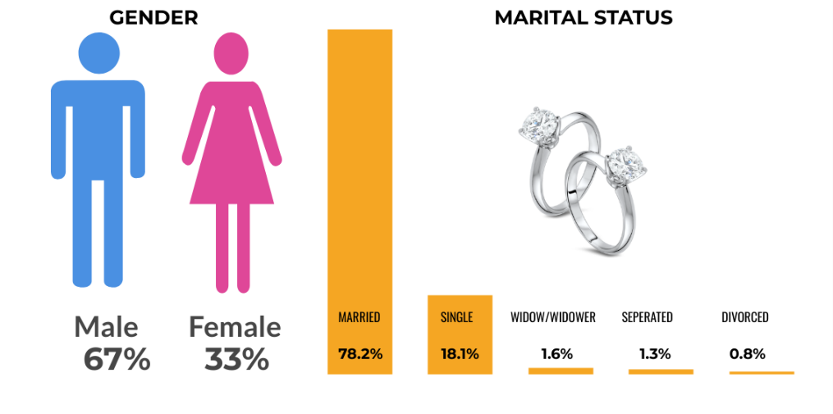
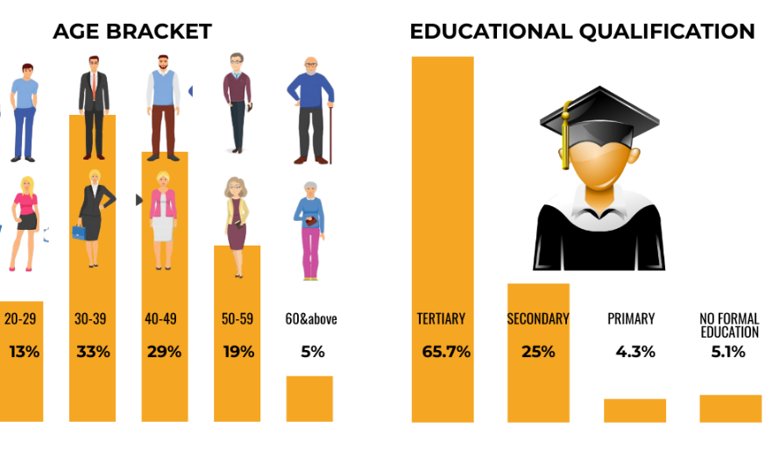
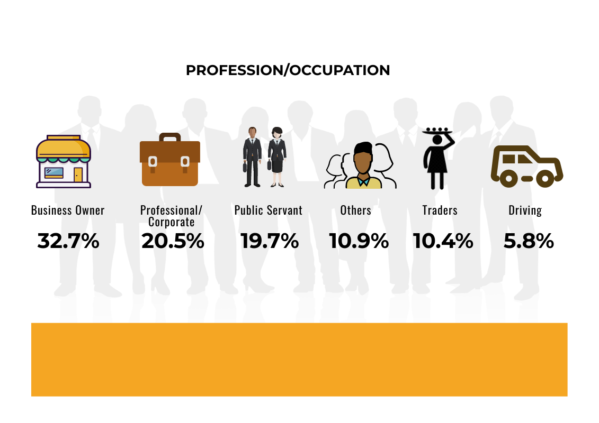
Demographic Data
78.2% of the respondents are married.
62% are between 30-49
95% had basic education.
53.2% are professional/corporate workers & public servants. 72.9% Other occupation, students 10.9%, traders 10.4% and drivers 5.8%.

Slide 17
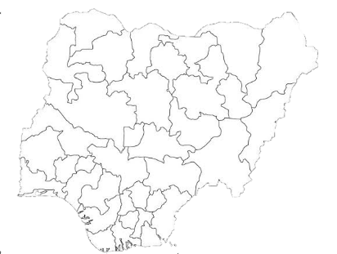

States of Origin
LAGOS
24.5%
OGUN
22.1%
OSUN
10.4%
OYO
7.4%
ONDO
6.6%
EKITI
4.8%
ANAMBRA
4%
DELTA
3.2%
KWARA
2.9%
ABIA
2.4%
EDO
2.4%
IMO
2.1%
KOGI
1.6%
BENUE
1.3%
ENUGU
1.1%
BAUCHI
0.5%
JIGAWA
0.5%
AKWA IBOM
0.3%
BAYELSA
0.3%
CROSS RIVER
0.3%
KOGI
0.3%
KATSINA
0.3%
NIGER
0.3%
RIVERS
0.3%
GHANA
0.3%
24.5% from Lagos, 22.1% from Ogun state, 51% from other states, and 0.3% (1 respondent) from Ghana
Where they live
AGEGE
51.3%
IFAKO-IJAIYE
21.8%
LAGOS ISLAND
6.1%
ALIMOSHO
5.9%
OGUN
5.3%
OJOKORO
4.5%
IKEJA
1.9%
OSHODI-ISOLO
0.8%
SURULERE
0.8%
KOSOFE
0.5%
ETI-OSA
0.3%
IKORODU
0.3%
SHOMOLU
0.3%
ILORIN
0.3%

Slide 18
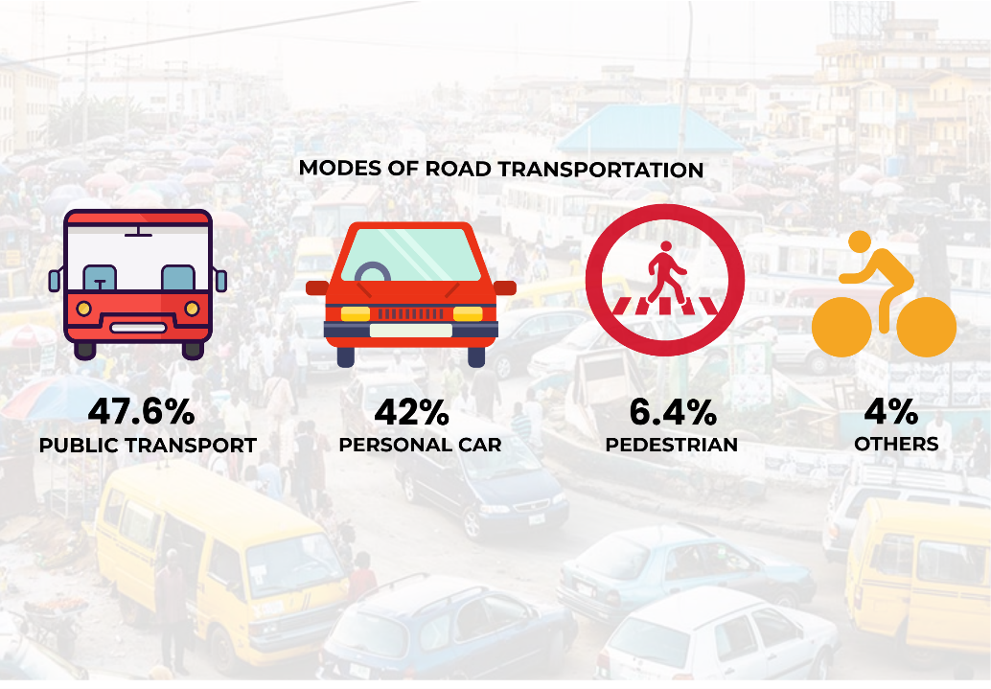
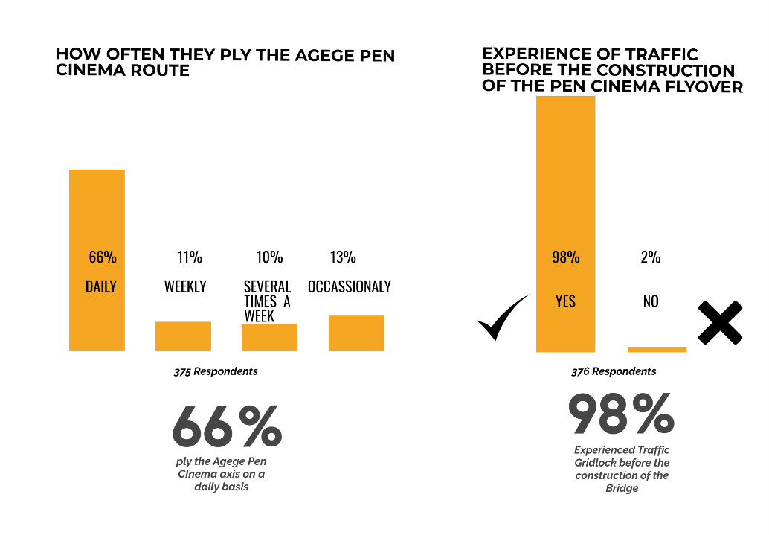
Objective 1
To determine the immediate impact of the flyover bridge in addressing the perennial gridlock associated with the axis.
47.6% Public transport
42% Personal car

Slide 19
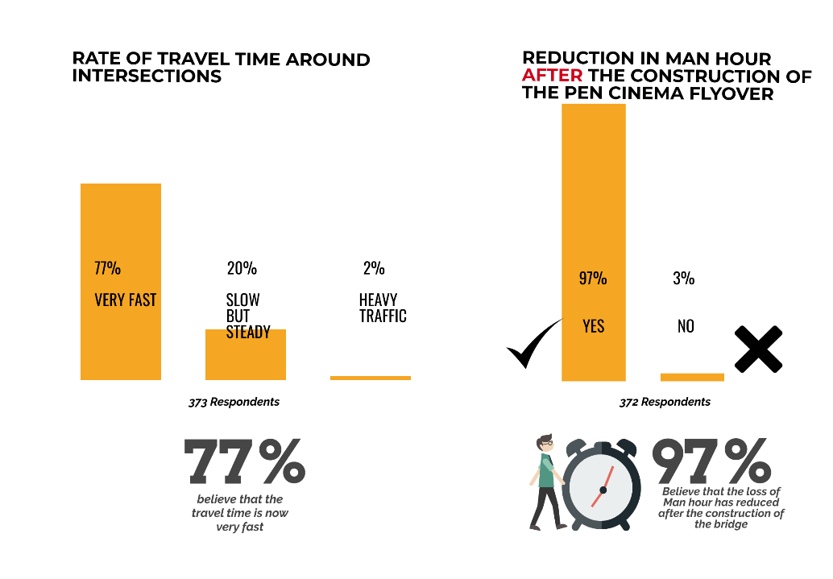
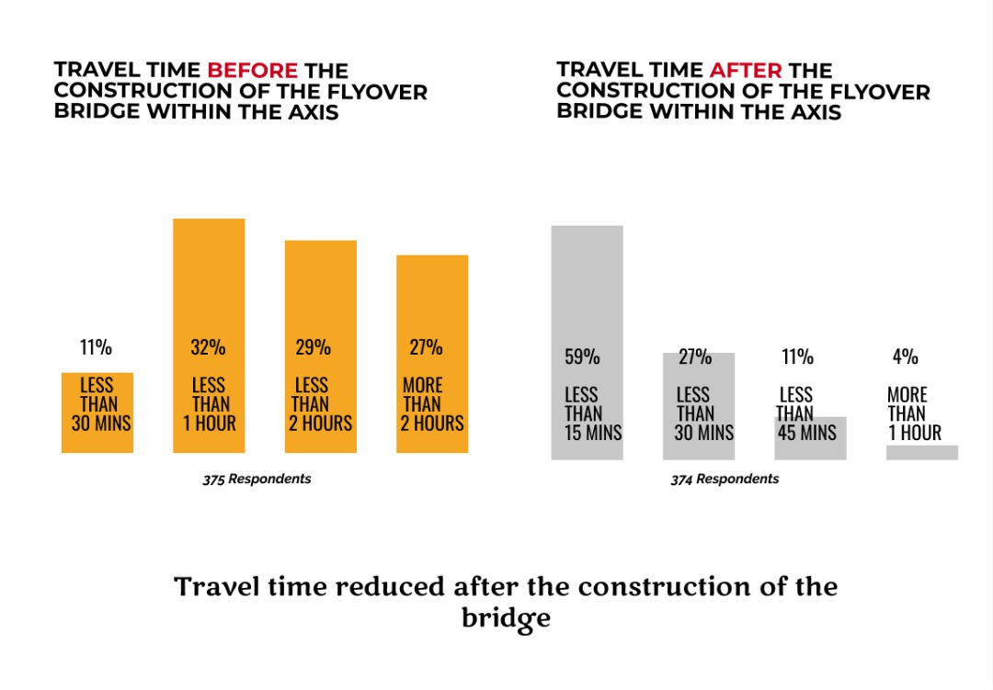
To determine the immediate impact of the flyover bridge in addressing the perennial gridlock associated with the axis.
84.6% says travel time is less than 30 minutes, 10.9% less than 45 minutes, 3.7% more than one hour

Slide 20
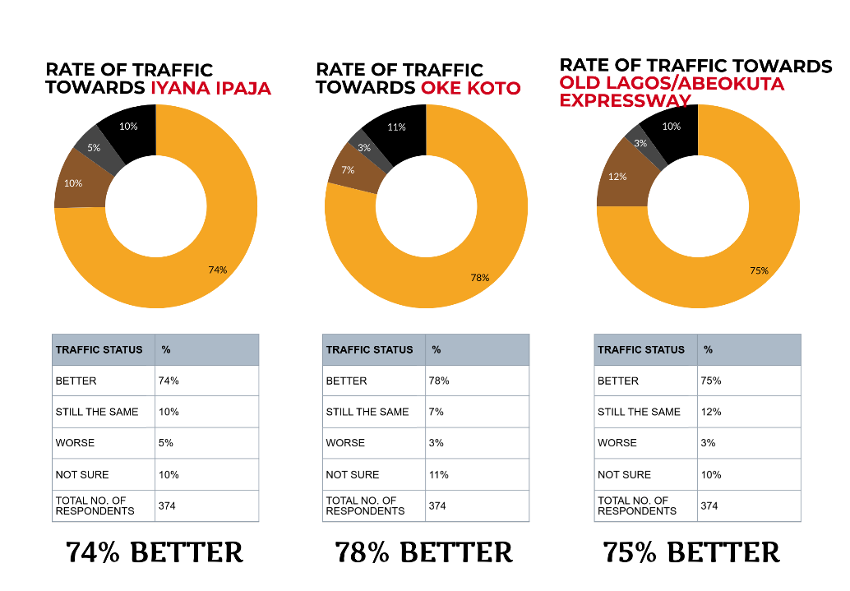
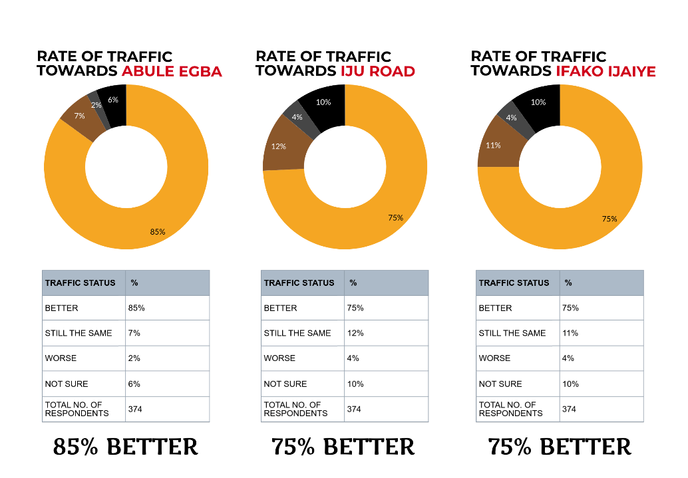
Rate of traffic after the construction within the axis

Slide 21
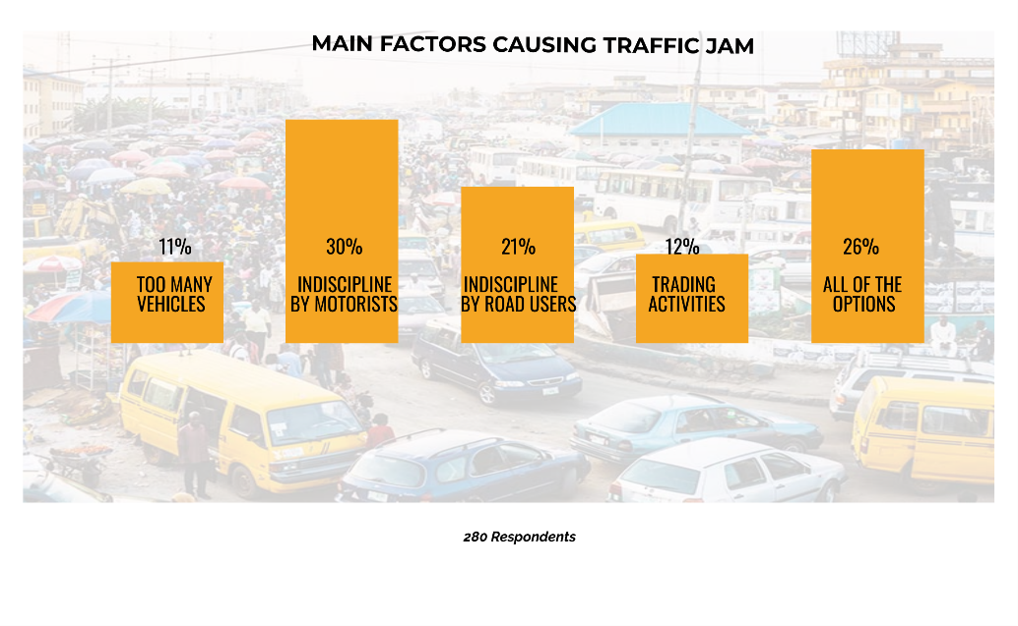
The main factor causing traffic jam was identified as indiscipline by motorists.

Slide 22
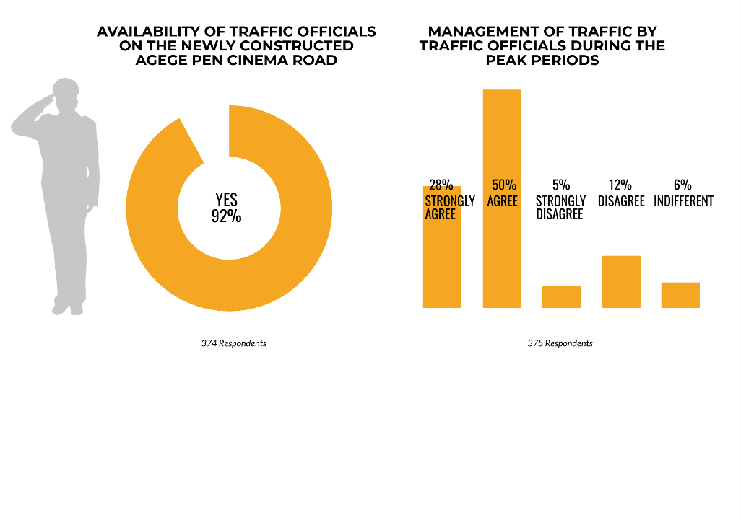
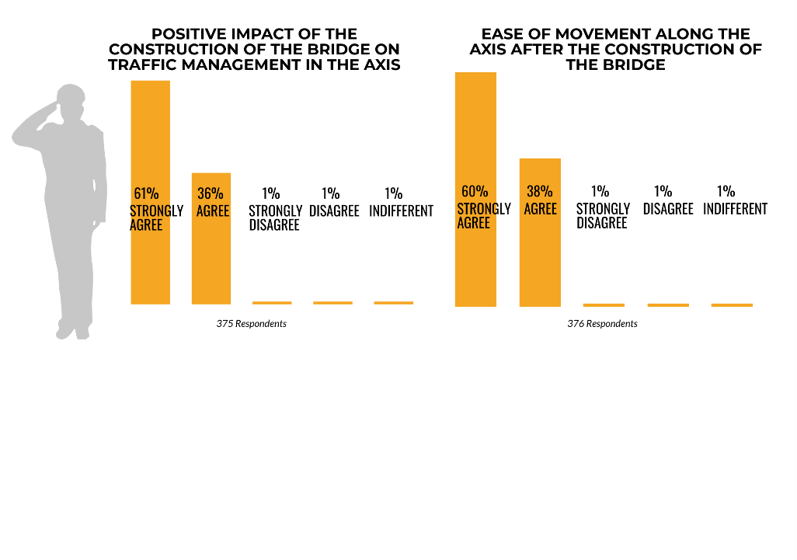
Objective 2
To examine the traffic management structure available along Agege corridor and other Intersections.
92% recognised the presence of traffic officials
78% approves traffic is properly managed during peak periods.
97% agreed that the bridge has positive impact on traffic management.
98% established that the bridge has eased movement.

Slide 23
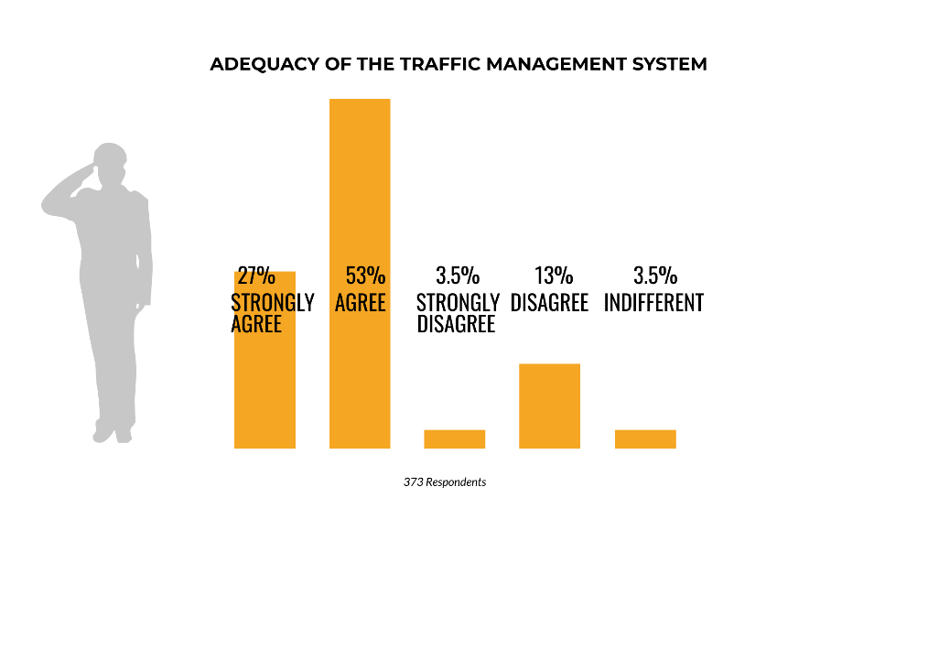
To examine the traffic management structure available
along Agege corridor and other Intersections.
80% of the commuters notified that the traffic management structure was adequate and has helped improve smooth movement and running of business in the axis.

Slide 24
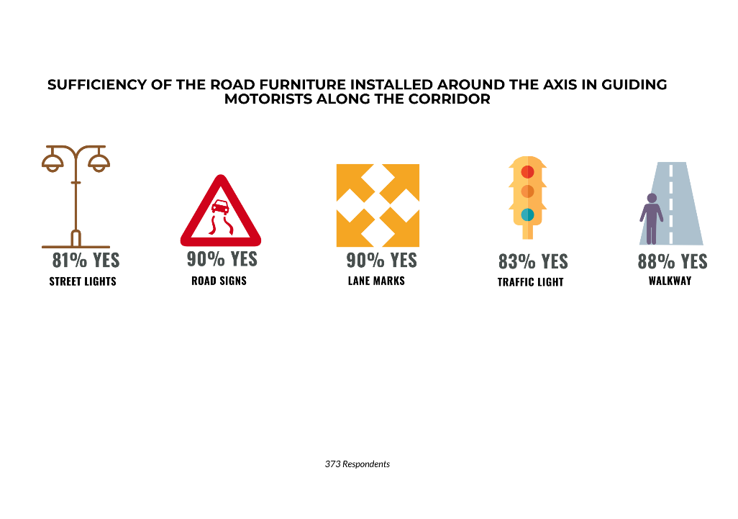
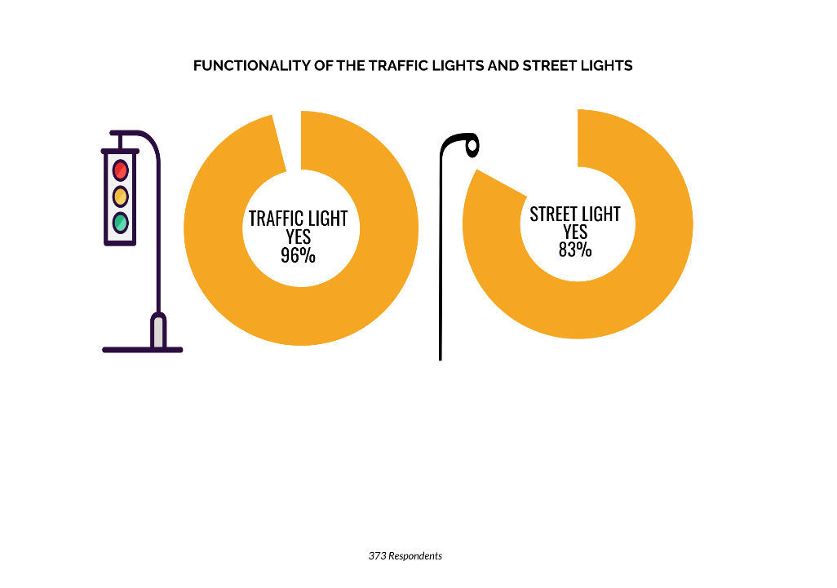
Objective 3
To Examine the effectiveness of the road furniture in place to ensure safety of lives and property.
79.5% says road furniture are effective.
The road furniture installed around the axis are sufficient in guiding motorists along the corridor.
The traffic lights and the streetlights installed are 96% and 83% functional.

Slide 25
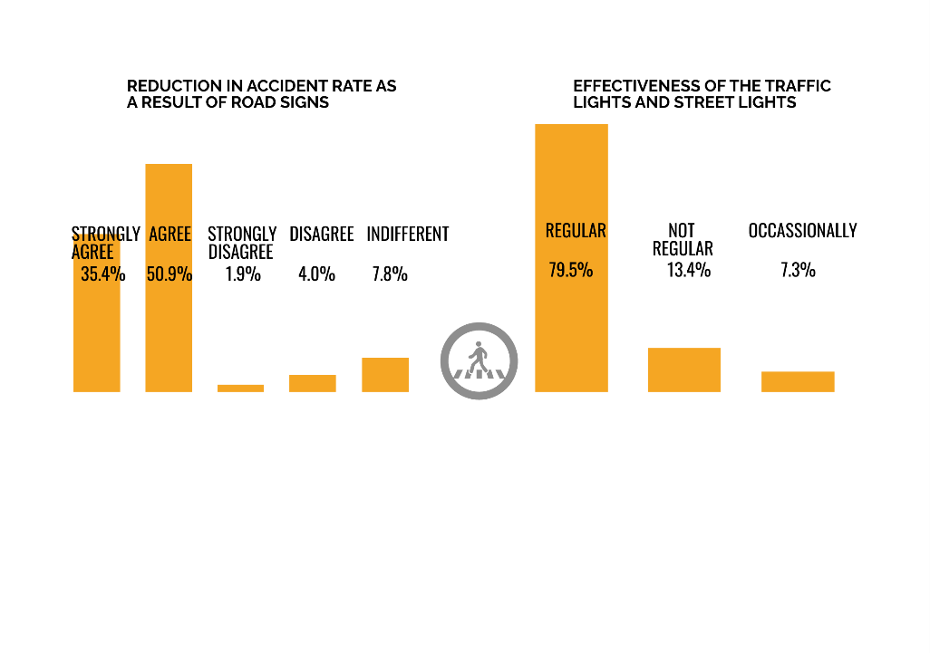
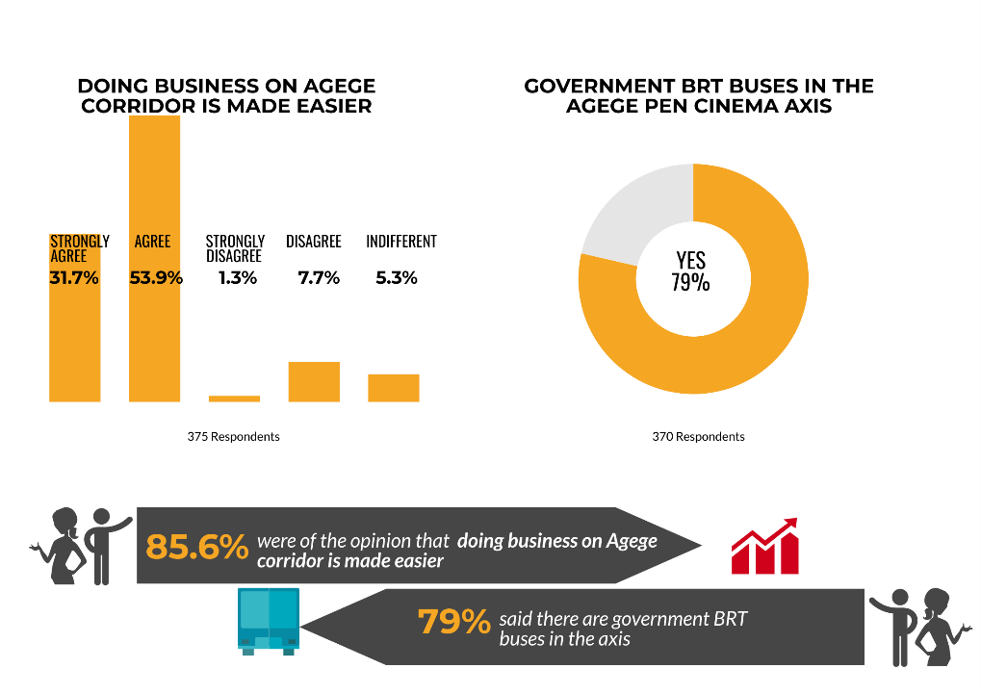
Objective 4
To Examine the socio-economic and physical development brought about by the completion of the flyover bridge to the people living in the area.
87.3% confirmed signs has helped in reduction of accident rate.

Slide 26
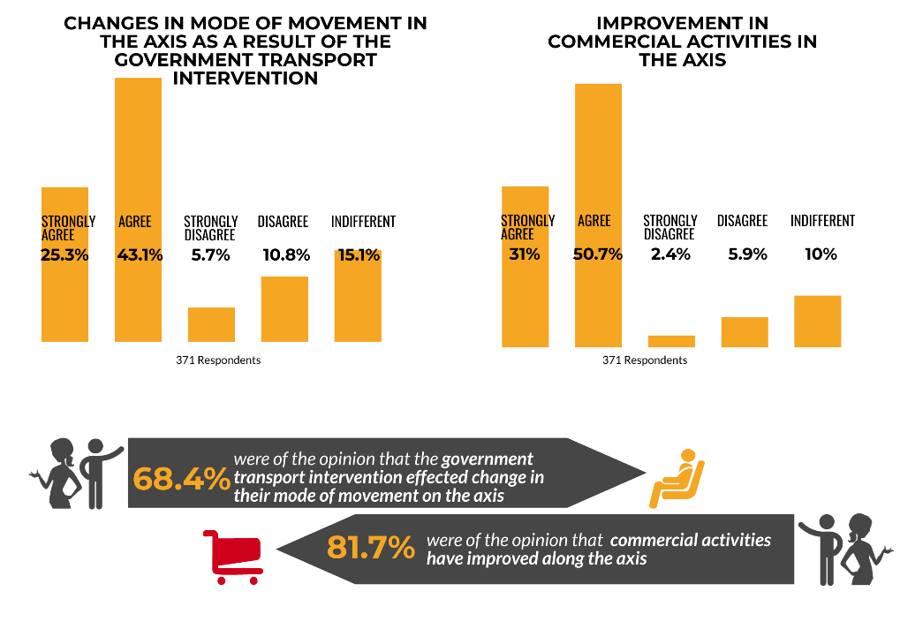
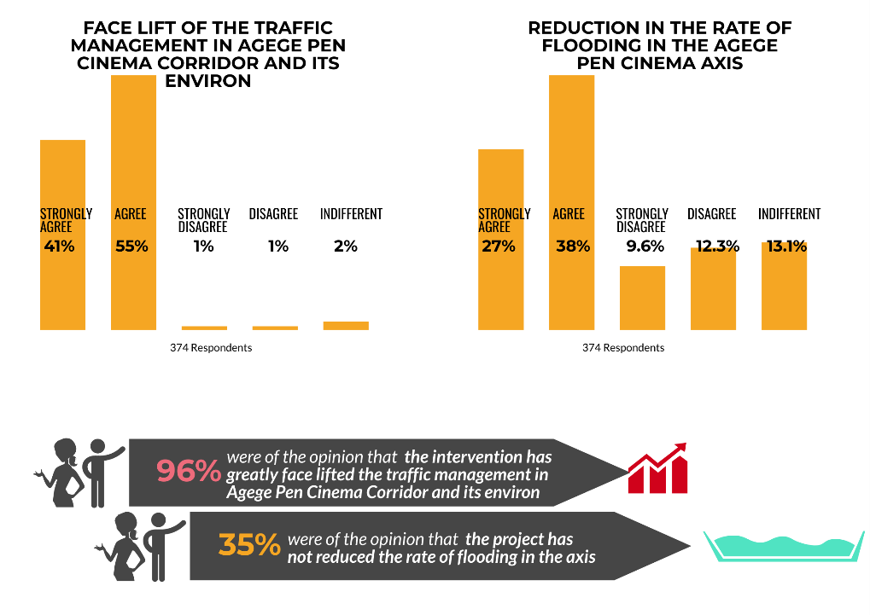
To Examine the socio-economic and physical development brought about by the completion of the flyover bridge to the people living in the area.

Slide 27
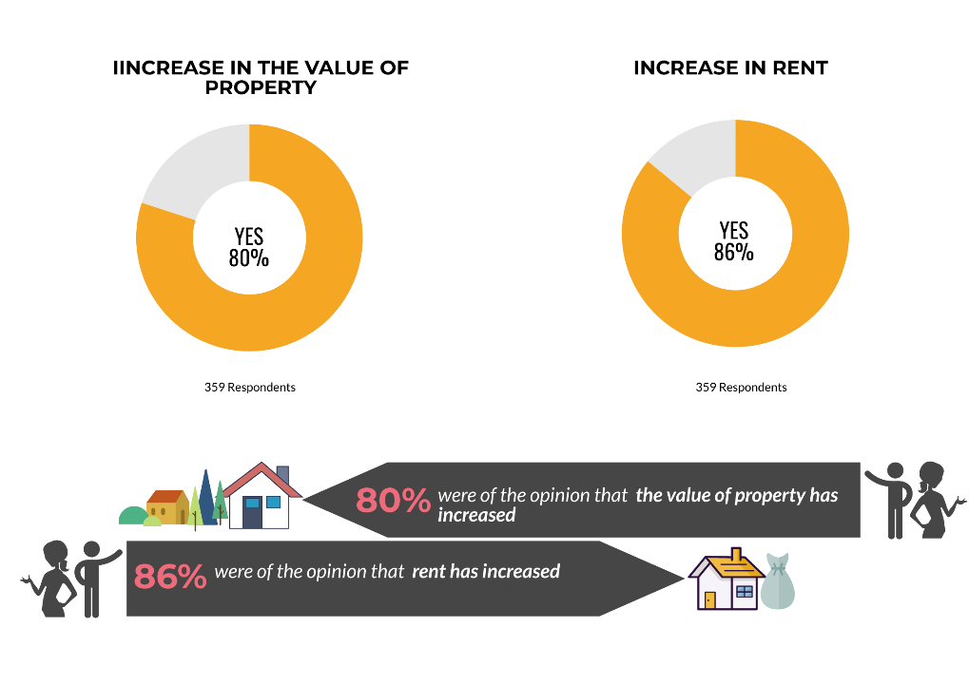
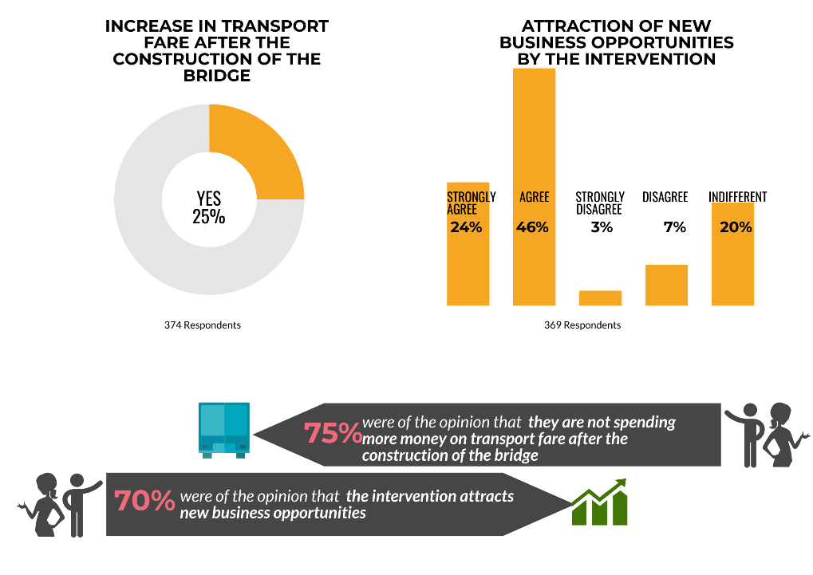
To Examine the socio-economic and physical development brought about by the completion of the flyover bridge to the people living in the area.

Slide 28
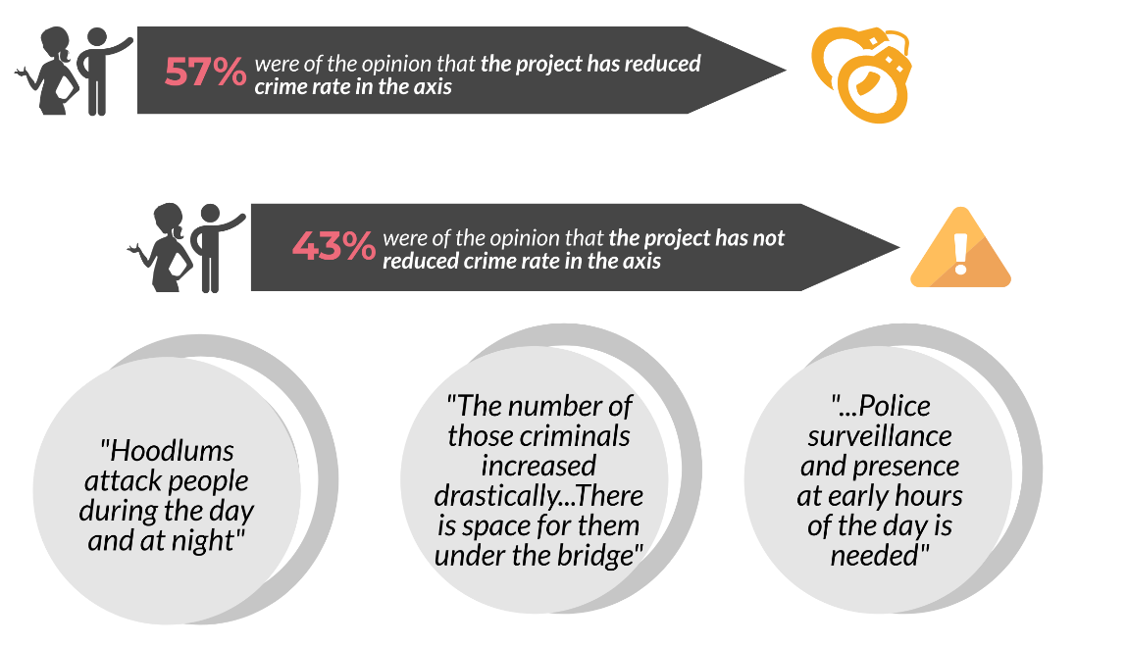
Crime rate in the Agege Pen-Cinema axis
376 Respondents

Slide 29
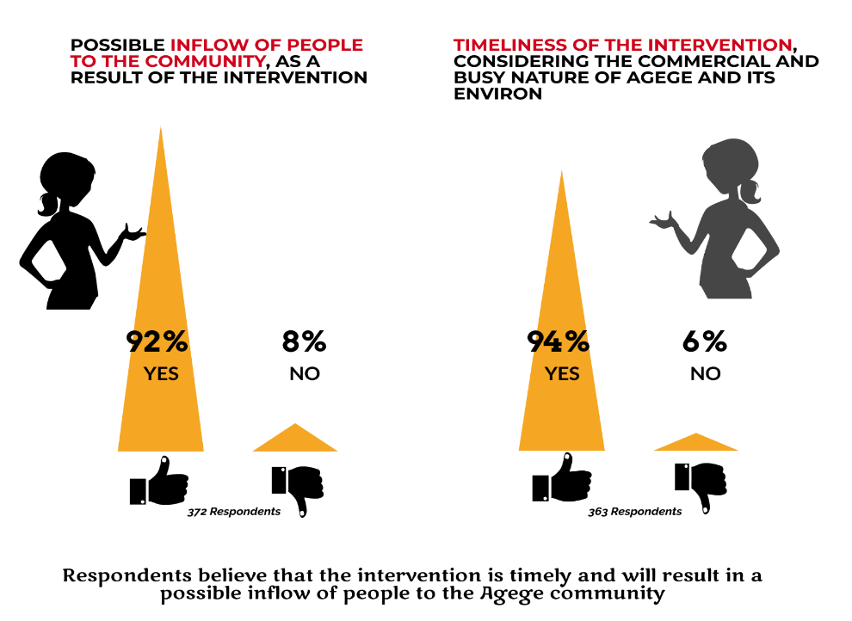
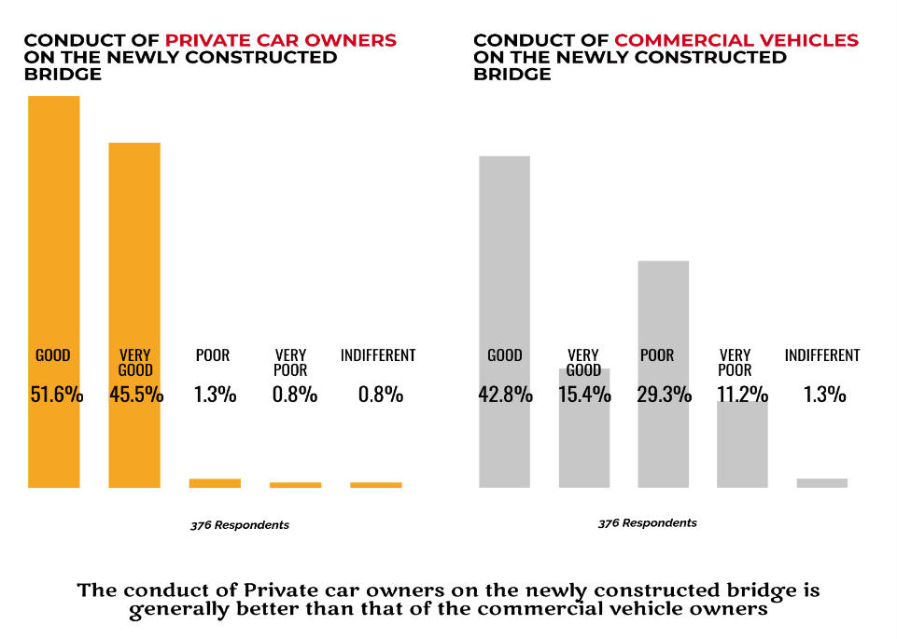
Objective 5
To Provide Feedback on the intervention for informed Policy and Future Decisions.

Slide 30
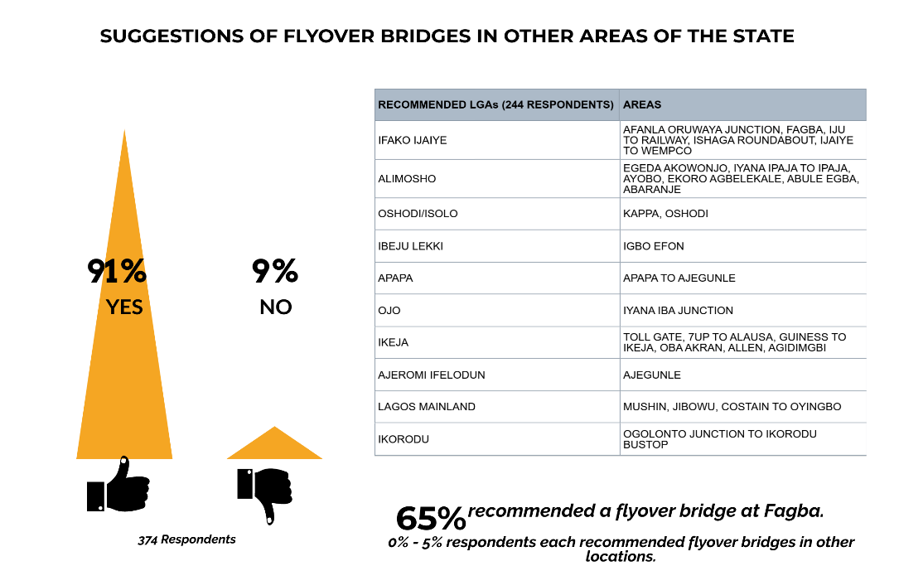

Slide 31
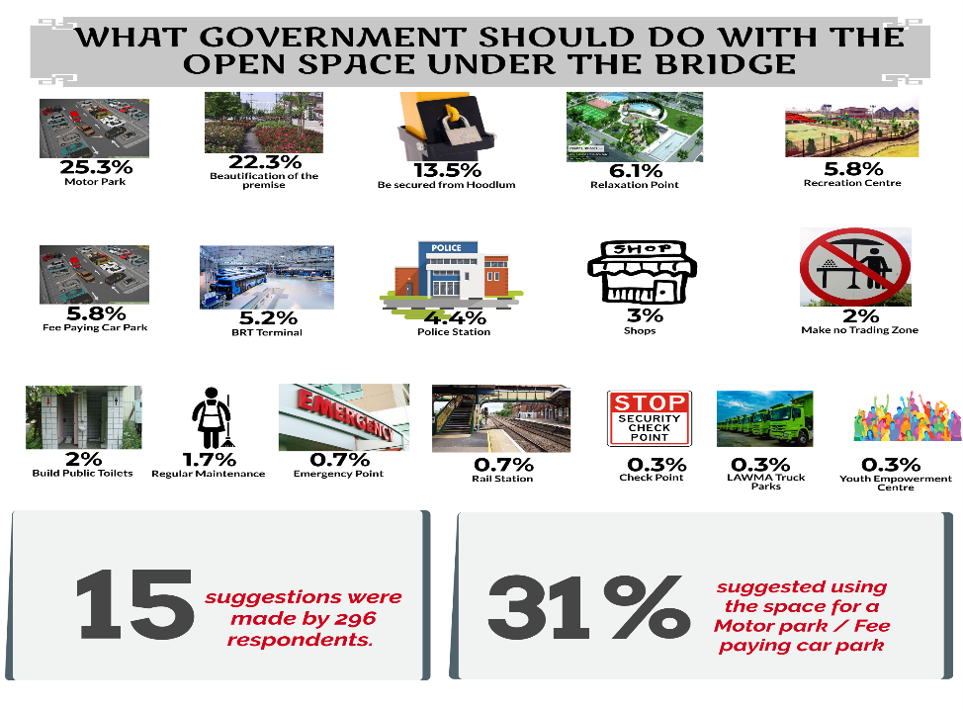

Slide 32
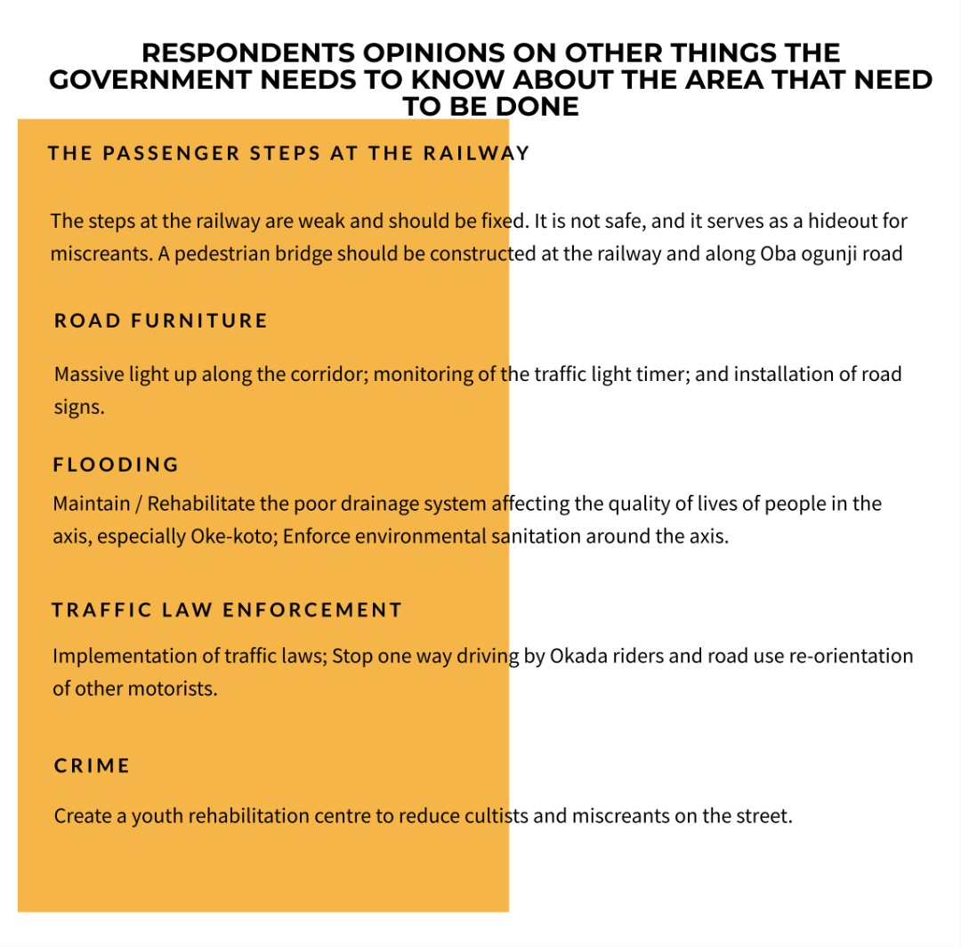
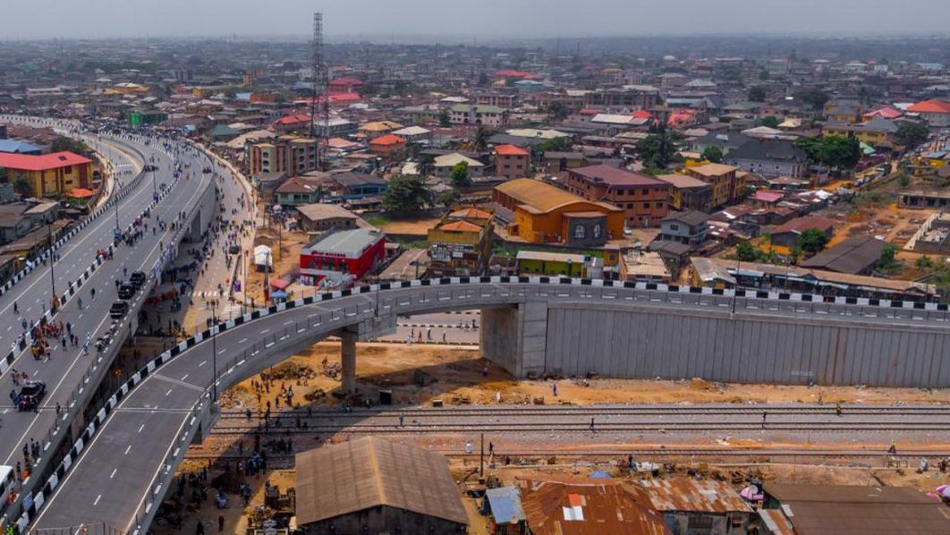

Slide 33
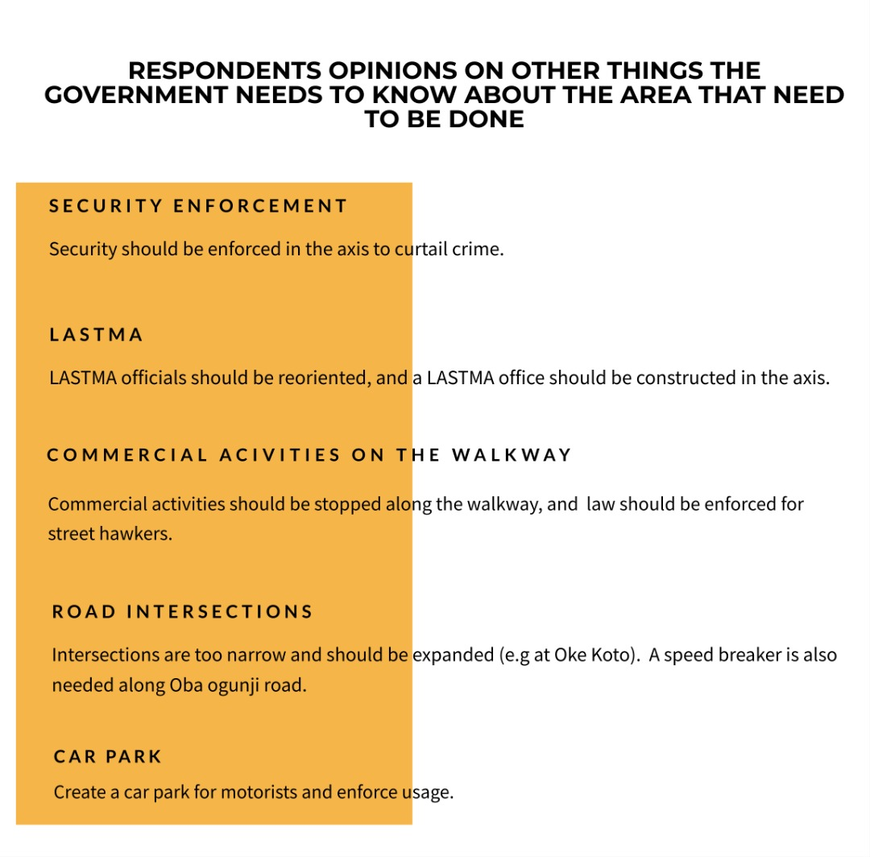

Slide 34

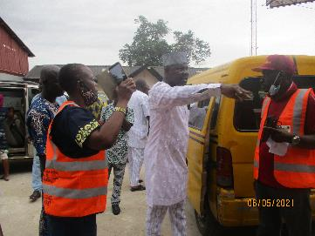
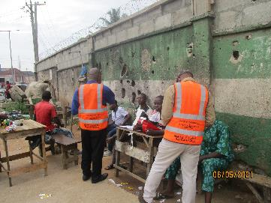
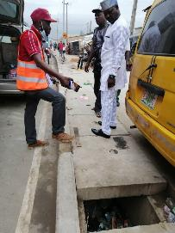
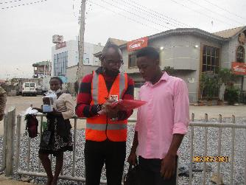
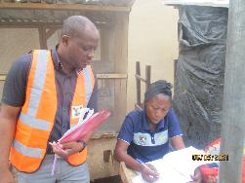
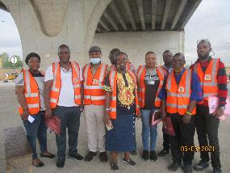
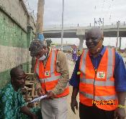
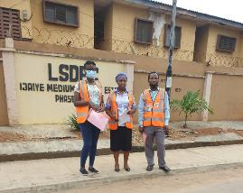
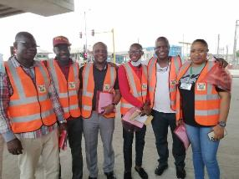
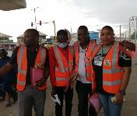
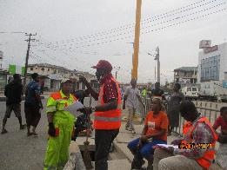
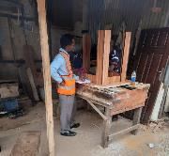
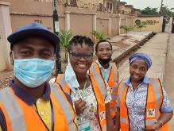
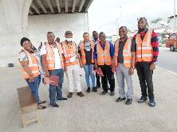
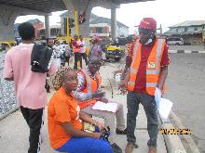
Pictures during field work

Slide 35

References
Adeniyi K(2000). “Transport challenges in Nigeria in the next Two decades 29th-31st August, 2020.
Agege Local Government Area (manpower.com.ng) retrieved on 8th June, 2021
Agege – Wikipedia retrieved on 7th June, 2021
Lagos Bureau of Statistics (2019). Abstract of Local Government Statistics

Slide 36
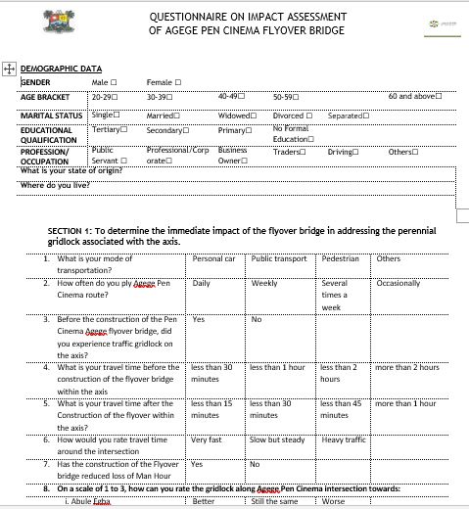

ANNEXURE I

Slide 37


ANNEXURE II

Slide 38


Slide 39


Slide 40





