Slide 1


LAGOS STATE GOVERNMENT
MINISTRY OF ECONOMIC PLANNING & BUDGET
Y2012
2nd QUARTER/MID-YEAR BUDGET
PERFORMANCE
APPRAISAL
By
Mr. Ben Akabueze
Hon. Commissioner (MEPB)
On Wednesday, 11th July, 2012
@
State House, Ikeja

Slide 2
OUTLINE
Purpose of the briefing
Y2012 Budget focus
Implementation Strategies
Notes from Q1
Q2 Performance Review
Mid-Year Budget Performance
  Revenue Appraisal
  Expenditure Appraisal
  Comparative Analysis
Observations
Conclusion(s)

Slide 3

Purpose of the briefing
  analyze and deliberate on Q2/Mid Year Budget performance
  establish areas that require improvement
  examine reasons for non-performance
  suggest the way forward

Slide 4
Y 2012 Budget
Preamble
Y2012 Budget of N491.941bn was signed into law by His Excellency, the Governor on the 3rd of January, 2012.
Underlying Policy Thrust of Government:
  Poverty Eradication and Sustainable Economic Growth Through Infrastructure Renewal and Development.

Slide 5

Y2012 BUDGET SIZE: 491.941bn
SECTORAL ALLOCATION

Slide 8
Y2012 Budget Focus
Security (including Food Security)
Transportation-Roads & Inter-modal Transportation System
Education
Health
Environment

Slide 9
Y2012 Budget Focus…..2/
Rural/Urban Development
Skill Acquisition/Microfinance
Water
Housing and Urban Renewal
E-Governance

Slide 10
Key Implementation Strategies
Revenue Stakeholders’ meeting with the Governor as a vehicle for sustained Revenue drive;
Enhanced transparency and accountability;
Efficient allocation of resources across sectors;
Tighter operating expenditure control;
Periodic review of performance;
More effective Project Monitoring;
Benchmark performance set at 90%

Slide 11
Notes from Q1 Review
The Overall budget performance was 65%; a way below the set benchmark of 90% but better than 52% for same period in Y2011
    Revenue - 85%
    Capital Receipts – 40%
    Recurrent Expenditure - 87%
        Personnel Cost – 93%
        Overhead Cost – 83%
        Capital Expenditure – 45%
    Financing - 52%
    Capital/Recurrent Ratio was 36:64 as against 53:47 benchmark.

Slide 12

Q1 vs. Q2 Y2012
 | Q1 |  |  | QQ22Q2
Details | Prov. Jan-Mar Nbn | Actual Jan-Mar Nbn | % Perf | Prov. Apr-June Nbn | Actual Apr-June Nbn | % Perf
Total Ordinary Revenue | 99.959 | 85.103 | 85 | 99.959 | 85.117 | 85
Total Recurrent Expenditure (i) Personnel Cost (ii) Overhead Cost | 58.405 20.406 37.999 | 50.736 19.046 31.690 | 87 93 83 | 58.405 20.406 37.999 | 51.858 17.793 34.065 | 89 87 90
Total Recurrent Surplus | 41.554 | 34.367 | 83 | 41.554 | 33.319 | 80
Total Capital Receipts | 6.419 | 2.596 | 40 | 6.419 | 3.216 | 50
Total Capital Expenditure | 64.580 | 28.995 | 45 | 64.580 | 51.900 | 80
Financing | (16.608) | (7.968) | (48) | (16.608) | (10.366) | 62
Budget Size | 122.985 | 79.731 | 65 | 122.985 | 103.758 | 84

Slide 13


Comparative Analysis of Q2 Budget Performance from Y2010 to Y2012
April - June
 | 2012 |  |  | 2011 |  |  | Y2010
Details | Prov. Apr-June | Actual Apr-June | % Perf | Prov. Apr-June | Actual Apr-June | % Perf | Prov. Apr-June | Actual Apr-June | % Perf
Total Ordinary Revenue | 99.959 | 85.177 | 85 | 88.080 | 78.513 | 89 | 76.757 | 70.692 | 92
Total Recurrent Expenditure | 58.405 | 51.858 17.793 34.065 | 89 | 49.546 | 45.411 | 92 | 41.254 | 39.400 | 96
Total Recurrent Surplus | 41.554 | 33.319 | 80 | 38.535 | 33.102 | 86 | 35.503 | 31.292 | 88
Total Capital Receipts | 6.419 | 3.216 | 54 | 4.815 | 1.387 | 29 | 7.093 | 2.078 | 29
Total Capital Expenditure | 64.580 | 51.900 | 80 | 63.148 | 24.744 | 39 | 56.139 | 68.664 | 122
Financing | (16.608) | (11.742) | 71 | (19.799) | 8.470 | -43 | (13.543) | 35.294 | 240
Budget Size | 122.985 | 103.758 | 84 | 112.694 | 70.155 | 62 | 97.393 | 108.064 | 111

Slide 14

Q2 2012 Vs Q2 2011 (April – June)
Budget Performance for the 2nd Quarter, Y2012 was 84% or N103.758bn as against 62% or N70.155bn same period in 2011; N33.60bn more in absolute terms
Total Ordinary Revenue (TOR) recorded N85.177 or 85 % compared to 89% or N78.513bn for same period in Y2011
Recurrent Expenditure was N51.858bn or 89% as against N45.411bn or 92% in 2011
Recurrent Surplus of 80% or N33.319bn as against
86% or N33.102bn same period Y2011
Capital Receipts was N3.216bn or 50% against N1.387bn or 29% same period in 2011
Capital Expenditure performed N51.900bn or 80% compared to N 24.744bn or 39% same period in Y2011

Slide 15

Half-Year Budget Performance Highlights
Details | Prov. Jan-June | Actual Jan-June | Performance %
Total Ordinary Revenue | 199.917 | 170.421 | 85
Total Recurrent Expenditure | 116.810 | 102.836 | 88
Total Recurrent Surplus | 83.107 | 67.585 | 81
Total Capital Receipts | 12.839 | 5.524 | 43
Total Capital Expenditure | 129.161 | 80.895 | 63
Financing | (33.215) | 6.729 | 20
Budget Size | 245.971 | 183.731 | 75

Slide 16


COMPARATIVE ANALYSIS OF HALF-YEAR Y2011 & Y2012
 | 2012 |  |  | 2011
Details | Prov. Jan-June | Actual Jan-June | % Perf | Prov. Jan-June | Actual Jan-June | % Perf
Total Ordinary Revenue | 199.917 | 170.421 | 85 | 176.160 | 152.921 | 87
Total Recurrent Expenditure | 116.810 | 102.836 | 88 | 99.091 | 86.816 | 88
Total Recurrent Surplus | 83.107 | 67.585 | 81 | 77.069 | 66.105 | 86
Total Capital Receipts | 12.839 | 5.524 | 43 | 9.631 | 2.654 | 28
Total Capital Expenditure | 129.161 | 80.895 | 63 | 126.297 | 42.247 | 34
Financing | (33.215) | 6.729 | 20 | (39.597) | 26.512 | (67)
Budget Size | 245.971 | 183.731 | 75 | 225.388 | 129.063 | 57

Slide 17


Y2012 Half-Year Revenue Performance
 | Y’12 Provision Nbn | Y’12 Provision Jan.– June Nbn | Y’12 Actual Jan.- June Nbn | Performance %
Total Ordinary Revenue (A+B) | 399.834 | 199.917 | 170.421 | 85
A Internally Generated Revenue | 289.676 | 144.838 | 113.700 | 79
I. L/S Internal Revenue Services (LIRS) | 211.000 | 105.500 | 91.996 | 87
II. Internally Generated Revenue (Others) | 41.475 | 20.738 | 11.258 | 54
III. Dedicated Revenue | 28.439 | 14.220 | 5.981 | 42
IV Extra Ordinary Revenue | 8.762 | 4.381 | 4.465 | 102
B. Federal Transfers | 110.158 | 55.079 | 56.721 | 103
I. Statutory Allocation | 57.662 | 28.831 | 26.711 | 93
II. Value Added Tax | 52.496 | 26.250 | 30.010 | 114
C. Capital Receipts | 25.677 | 12.839 | 5.524 | 43

Slide 18
Half-Year Revenue Appraisal
Total Ordinary Revenue (TOR) performed N170.421bn representing 85% of target compared to 87% or N152.921bn for Y2011, though N17.500bn more in absolute terms
Internally Generated Revenue (IGR) was N113.700bn or 79%, against N102.290bn or 78% during same period in Y2011; and 67% of TOR vs. 67% in Y2011
Dedicated Revenue made N5.981bn representing 5.3% of IGR and 3.5% of the TOR
LIRS performance of N91.996bn accounted for 81% of the IGR and 54% of the TOR, compared to 86 % of IGR and 57% of TOR in Y2011, but N4.02bn more in absolute terms

Slide 19
Half-Year Revenue Appraisal……2/
Capital Receipts performed at N5.524bn or 4.9% of the IGR and 3.2% of the TOR respectively
Federal Transfers contributed N56.721bn representing 33% of the TOR; Statutory Allocation contributed N26.711bn or 93%,while VAT performed at 114% of budget

Slide 20
HALF-YEAR REVENUE PERFORMANCE
FROM 2008 TO Y2012
YEAR | PROVISION Nbn Jan– June | ACTUAL Nbn Jan– June | Performance %
2008 | 106.217 | 87.262 | 82
2009 | 144.482 | 121.595 | 84
2010 | 153.514 | 133.526 | 87
2011 | 176.160 | 152.921 | 87
2012 | 199.917 | 170.421 | 85

Slide 21
Appraisal of Capital Receipts; Jan.–June 2012
Details | Provision N (billion) | Actual N (billion) | % Performance
Grants (Donor Agencies) | 1.734 | 1.374 | 79
Investment Income | 0.145 | - | -
Other Capital Receipts | 10.960 | 4.150 | 38
TOTAL CAPITAL RECEIPTS | 12.840 | 5.524 | 43

Slide 22
Capital Receipts Appraisal
Total Capital Receipts performed below expectation at N5.524bn or 43%,but better than Q2 Y2011 which was N2.654bn or 28%
Investment Income reported as N0.544bn by STO actually represents misclassifications of Interest Incomes; Actual Investment Income for the period was nil
Other Capital Receipts (Dedicated) performed at N4.150bn or 38% of projection
Responsible Agencies are:(individual performance details not available)
    Waterfront Infrastructure Development
    Housing
    Physical Planning & Urban Development
    New Towns Development Authority

Slide 23
Capital Receipts Appraisal…….2/
With pressure on our main IGR source (PAYE) and challenges in actualizing the State’s Borrowing programme for Y2012, Capital Receipts represent a viable source of revenues to ensure satisfactory performance of the budget
We believe it is time to mount a deliberate and concerted drive for revenues by the concerned Agencies, each of which should be required to present a plan of action within the Q3 in Y2012

Slide 24
HALF-YEAR CAPITAL RECEIPTS PERFORMANCE
FROM 2009 TO Y2012
YEAR | PROVISION Nbn Jan. – June | ACTUAL Nbn Jan. - June | %
2009 | 21.101 | 8.262 | 39
2010 | 14.187 | 4.475 | 32
2011 | 9.631 | 2.654 | 28
2012 | 12.840 | 5.524 | 43

Slide 25

Personnel Cost (Jan-June12)
Detail | Provision (Nbn) | Actual Nbn | % Performance
Total Personnel Cost | 40.813 | 37.081 | 91
Personnel Costs (including Consolidated) | 33.148 | 32.400 | 98
NYSC/Interns(Allowances) | 0.150 | 0.137 | 91
Other Personnel Costs (Contingency) | 0.335 | - | -
7.5% Govt. Share of Contributory Pensions | 2.402 | 1.450 | 60

Slide 26

Personnel Cost (Jan-June ‘12)…...2/
 | Provision (Nbn) | Actual Nbn | % Performance
5% Pension Redemption Bond Fund | 1.602 | 1.352 | 84
Pension & Gratuities(Civil Servants, Teachers) | 2.350 | 1.037 | 44
Pensions & Gratuities(Lagos State High Court) | 0.127 | 0.060 | 47
Pensions & Gratuities(Others) | 0.100 | 0.045 | 45
Pension Sinking Fund | 0.600 | 0.600 | 100

Slide 27

Half-Year Personnel Cost Performance Appraisal
Total Personnel Cost (TPC)was N37.081bn recording marginal decrease on half-year Y2011 at N37.964
TPC gulped N37.081 or 33% of IGR and 22% of TOR and 36% of Total Recurrent Expenditure

Slide 28

HALF-YEAR PERSONNEL BUDGET PERFORMANCE
FROM 2008 TO Y2012
YEAR | PROVISION Nbn Jan. – June | ACTUAL Nb Jan. – June | % Performance
2008 | 24.046 | 18.903 | 79
2009 | 27.172 | 20.338 | 75
2010 | 22.540 | 24.933 | 111
2011 | 34.115 | 37.964 | 111
2012 | 40.813 | 37.081 | 91

Slide 29

Overhead Cost (Jan. – June’12)
 | Provision Budget (Nbn) | Actual (Nbn) | % Performance
Total Overhead Costs | 75.998 | 65.755 | 87
Overhead Costs | 42.791 | 49.374 | 115
Dedicated Expenditure | 12.798 | 3.417 | 27
Subvention | 14.459 | 6.229 | 43
Staff Housing Fund | 0.025 | - | -

Slide 30
Overhead Cost (Jan. – June’12)….2/
 | Provision Budget (Nbn) | Actual (Nbn) | % Performance
External Debt Charges | 0.525 | 0.352 | 67
Internal Debt Charges | 3.479 | 6.383 | 183
Debt Charges (Bond) | 1.921 | - | -

Slide 31
Overhead Cost Appraisal
      Total Overhead Cost performed at N65.755bn or 87%; recording 64% of the Total Recurrent Expenditure and 58% of IGR
      Concerted action is required by all to contain Overheads
      Debt Charges on Internal Debts amounted to 183% of budget, mainly indicating higher borrowing costs

Slide 32
HALF-YEAR RECURRENT EXPENDITURE
FROM Y2008 TO Y2012
YEAR | PROVISION (N bn) | ACTUAL (N bn) | Performance%
2008 | 79.816 | 55.236 | 69
2009 | 79.732 | 56.748 | 71
2010 | 82.508 | 72.515 | 88
2011 | 99.091 | 86.816 | 88
2012 | 116.810 | 102.836 | 88

Slide 33
Capital Expenditure (Jan. –June12)
Details | Budget N (billion) | Actual N (billion) | % Performance
Core Capital | 112.184 | 74.133 | 66
Capital Development | 10.960 | 2.781 | 25
Risk Retention Fund | 0.050 | - | -
Special Expenditure | 2.500 | 2.032 | 81
Grants from Donor Agencies | 1.734 | 1.374 | 79
Counterpart Fund | 1.733 | 0.575 | 33
Total | 129.161 | 80.895 | 63

Slide 34


Capital Expenditure Appraisal
Half-Year performance was N80.895bn or 63% as against N42.247bn or 33% in Q2 Y2011;Performance improving, but still lower than the minimum target of 90%
For half-year 2012, Capex:Recurrent ratio was 44:56 as against the 53:47 set target; better than 33:67 in Q2 Y2011
Resolute action is required by all concerned to significantly shore up performance during Q3 by tightening expenditure control, more focused treasury management and intensification of Revenue drive

Slide 35
HALF-YEAR CAPITAL BUDGET PERFORMANCE
FROM 2008 TO 2012
YEAR | PROVISION Nbn Jan.– June | ACTUAL Nbn Jan. – June | %
2008 | 121.889 | 74.518 | 61
2009 | 122.768 | 78.875 | 64
2010 | 112.278 | 83.334 | 74
2011 | 126.297 | 42.247 | 33
2012 | 129.161 | 80.895 | 63

Slide 36

HALF-YEAR CAPITAL /RECURRENT RATIO
FROM Y2008 TO Y2012
YEAR | BUDGET PROJECTION | ACTUAL PERFORMANCE
2008 | 61:39 | 59:41
2009 | 60:40 | 60:40
2010 | 58:42 | 53:47
2011 | 56:44 | 33:67
2012 | 53:47 | 44:56

Slide 37


Half-Year Y2012 Financing Activities
Detail | Approved Budget | Approved Budget Jan – June | Actual Jan-June | % Perf.
 | Nbn | Nbn | Nbn
FINANCING REQUIREMENT | (66.430) | (33.215) | (7.786) | 23
FINANCING | 66.430 | 33.215 | 6.729 | 20
FINANCING (SOURCES) | 145.593 | 72.797 | 35.297 | 48
External Loans
(i) DPO | 30.000 | 15.000 | - | -
(ii) Others | 27.664 | 13.832 | 5.297 | 38
Internal Loans | 37.929 | 18.965 | 30.000 | 158
Bond Issue | 50.000 | 25.000 | - | -
REPAYMENTS | 79.163 | 39.582 | 28.568 | 72
External Loans (Principal Repayments) | 0.613 | 0.307 | 0.416 | 136
Internal Loan (Principal Repayments) | 36.811 | 18.406 | 14.898 | 81
Consolidated Debt Service Accounts | 41.739 | 20.870 | 13.254 | 64

Slide 38
Y2012 Financing Activities cont’d
Financing Activities for half-year 2012 show that despite a net revenue surplus of N 67.585bn, the State borrowed a net amount of N6.729bn
Ministry of Finance & Debt Management Office need to drive budgeted loan draw-downs intensively or seek urgent restructuring of the Borrowing Plan to ensure budget performance for the year is not adversely affected severely

Slide 39
TOTAL VALUE OF PRE-PAYMENT CERTIFICATIONS FOR THE PERIOD APRIL-JUNE, 2012 [BY SECTOR]
S/N | SECTOR | No of Pc | Total Contract Sum | Advance/Previous Payment | Amount Due
1 | General Public Services | 11 | 839,288,315.65 | 678,644,730.13 | 158,175,003.76
2 | Education | 49 | 1,572,067,834.26 | 1,177,380,044.33 | 267,344,618.06
3 | Environmental Protection | 25 | 7,118,736,651.50 | 4,167,628,785.55 | 653,207,227.66
4 | Economic Affairs | 34 | 25,426,045,681.72 | 17,411,636,181.52 | 3,460,505,091.40
5 | Health | 7 | 2,759,806,422.87 | 2,478,960,046.13 | 274,421,376.74
6 | Housing Community Amenities | 31 | 1,844,664,417.40 | 1,397,559,566.69 | 193,643,355.32
7 | Recreation, Culture and Religion | 1 | 25,000,000.00 | 10,000,000.00 | 5,200,000.00
8 | Public Order and Safety | 2 | 555,040,000.00 | 340,272,750.00 | 94,544,600.00
9 | Social Protection | 0 | 0 | 0 | 0
 | TOTAL | 160 | 40,140,649,323.40 | 27,662,082,104.35 | 5,107,041,272.94

Slide 40
SUMMARY OF RETURNED PAYMENT CERITIFICATE’S FOR THE PERIOD OF APRIL-JUNE, 2012.
S/N | Sector | MDA | No of Pc | Total Contract Sum | Advance/Previous Payment | Amount Due
1 | Education | Education | 1 | 38,095,218.37 | 22,857,131.02 | 13,323,538.26
 |  | SUBEB | 2 | 15,909,797.52 | 15,114,307.64 | 795,489.88
 |  | SCRPS | 3 | 127,443,898.79 | 77,020,065.38 | 44,296,965.01
2 | Environment Protection | Environment | 1 | 36,000,000.00 | 25,132,012.70 | 6,350,266.03
 |  | Environment | 2 | 425,000,000.00 | 353,896,104.67 | 38,689,805.23
3 | Economic Affairs | LAMATA | 1 | 1,275,000,000.00 | 637,500,000.00 | 267,750,000.00
 |  | Works & Infrastructure | 3 | 1,853,072,989.69 | 1,132,339,488.49 | 93,642,120.91
 |  | Works & Infrastructure | 2 | 100,000,000.00 |  | 100,000,000.00
4 | Housing & Com. Amenities | NTDA | 1 | 61,089,842.00 | 24,435,937.00 | 20,340,351.73
 |  | NTDA | 1 | 36,958,158.11 | 14,783,263.24 | 13,297,942.56
 |  | Rural | 1 | 9,620,338.25 | 5,772,202.95 | 481,016.91
 | TOTAL |  | 18 | 3,978,190,242.73 | 2,308,850,513.09 | 598,967,496.52

Slide 41

Reasons for Returned Certificates
Payment Certificates did not conform with the standard format
Sub-standard quality of work
5%VAT and 5%retention were not recognized in the Payment certificates.
Non conformity to release of Stage/Final payments
Mobilization fees not exhausted

Slide 42

Comparative Analysis of Amount Due by Sectors between Q2 – 2011 & Q2-2012
S/N | SECTORS | Amount Due, 2011 | Amount Due, 2012
1 | General Public Service | 306,873,744.70 | 678,644,730.13
2 | Education | 543,370,977.53 | 1,177,380,044.33
3 | Environmental Protection | 475,798,107.93 | 4,167,628,785.55
4 | Economic Affairs | 4,830,765,615.27 | 17,411,636,181.52
5 | Health | 707,034,710.85 | 2,478,960,046.13
6 | Housing Community Amenities | 1,035,863,727.65 | 1,397,559,566.69
7 | Recreation, Culture & religion | 14,692,500.00 | 10,000,000.00
8 | Public Order & Safety | - | 340,272,750.00
 | Total | 27,662,082,104.35 | 5,107,041,272.94

Slide 43
OBSERVATIONS/RECOMMENDATIONS
The Overall Budget performance of was 75% ; still short of the set benchmark of 90%; budget is revenue-driven
Revenue Generating Agencies other than LIRS performed at average of 52%; such MDAs need to heed call for intensive revenue generation monitoring to improve on their performance;
Efforts at improving the accounting for Government revenues need to be stepped up
Recurrent Expenditure is still crowding out much-needed Capital expenditure; Continuing efforts at control on Recurrent Expenditure to free funds for Capital Projects is imperative

Slide 44


OBSERVATIONS/RECOMMENDATIONS……..2/
MOF & DMO need to expedite action in Y2012 on planned loan draw-downs or restructuring of same, as the net financing programme accounts for 13.5 % of budgeted expenditure
6. Absence of reliable baseline information. [All MDAs]
  Improper discharge of storm water at Odongunyan/Odonla in Ikorodu (Environment)
  Defective project design at Oje Imahvin street ,Oregun(W &I)

Slide 45
OBSERVATIONS/RECOMMENDATIONS……..3/
  Location of ‘World class’ Park under high tension wire of PHCN at Ayobo (Environment)
Recommendations
    STB must ensure strict compliance with MEPB Circular on baseline

Slide 46
OBSERVATIONS/RECOMMENDATIONS……..4/
Lack of proper coordination among MDAs .
  Construction of Ipaja- Ayobo Road( MOW &I and Environment)
  Construction of Drainage Channel at Ogba/WEMPCO Road(LAMATA& ENVIRONMENT).
Recommendations
  MDAs should improve their collaborative efforts
  STB should ensure submission of implementation plan before award
Lack of adequate planning before Projects implementation
  Provision of water scheme by MRD without adequate arrangement for power and maintenance.

Slide 47
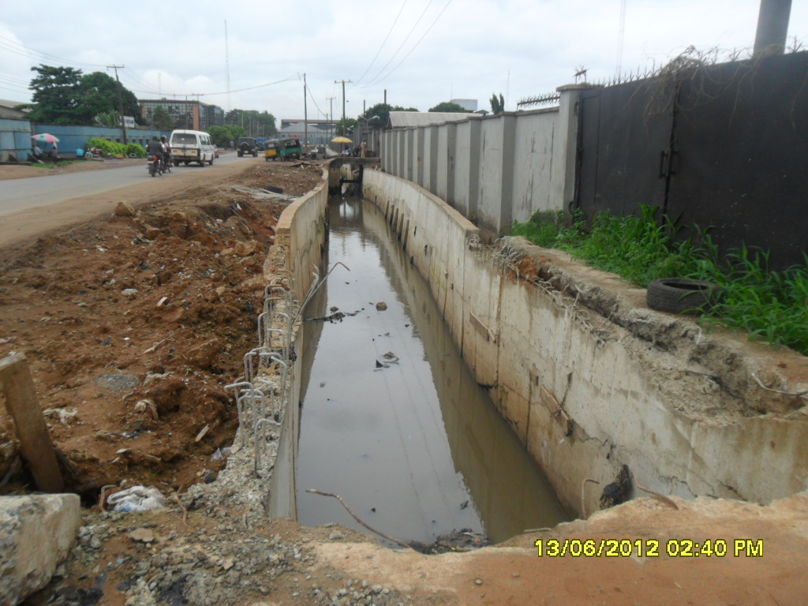
Construction of Drainage Channel at Ogba/WEMPCO Road

Slide 48
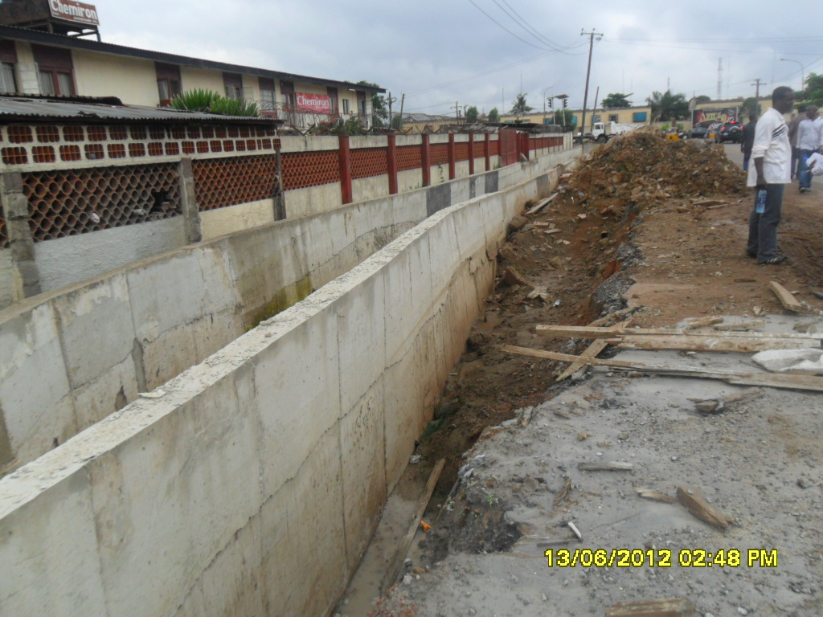
Construction of Drainage Channel at Ogba/WEMPCO Road

Slide 49
PRAYERS
The Executive Council and the Body of Permanent Secretaries are invited to:
note that the Y2012 Budget size was N491.941bn. The prorated budget size for the 2ndQuarter was N245.970bn
note that the overall performance for the half-year was N183.731 in absolute terms or 75% compared to N129.063bn or 57% for same period in Y2011;
note that the Total Ordinary Revenue performed at 85% or N170.421 bn.
note that the Total Capital Receipts for the period amounted to N5.524bn representing 43% of actual projection;

Slide 50
PRAYERS………2/
note that the Recurrent Expenditure for the period was N102.836bn representing 88% or (Personnel Cost 91%; Overhead Cost 87%)
note that the Capital Expenditure performance was N80.895bn or 63% ;
vi note that Capital/Recurrent Expenditure Ratio closed at 44: 56 as against 53 : 47 projected for the period under review;
vii note and consider all the observations and recommendations raised; and
viii approve the Y2012 Half-Year Budget Appraisal as presented .

