Slide 1
LAGOS STATE GOVERNMENT
MINISTRY OF ECONOMIC PLANNING AND BUDGET
Y2016 BUDGET
2ND QUARTER
PERFORMANCE APPRAISAL
By
Mr. Akinyemi Ashade
Honourable Commissioner
Ministry of Economic Planning and Budget
at
Lagos House, Ikeja
On Friday,8th July, 2016
1

Slide 2
Outline
Purpose of the Presentation
Y2016 Budget Overview
Y2016 Budget Focus and Priorities
Y2016 Key Implementation Strategies
Review of First Quarter
Highlights of Q2 Budget Performance Review (Apr.-Jun, 2016)
  Revenue Appraisal
  Expenditure Appraisal
  Comparative Analysis
Observations and Recommendations
Summary/Conclusion(s)
Annexures

Slide 3
Purpose of the Presentation
  Analyze and deliberate on Q2 (Apr.-Jun.) 2016 budget performance
  Establish areas that require improvement
  Examine reasons for non-performance where applicable; and
  Suggest the way forward
3

Slide 4
Y2016 Approved Budget Overview
4
4

Slide 5
Y2016 Budget
SN | Details | Y2016 Budget (N’bn)
1. | Total revenue | 542.874
2. | Total recurrent expenditure (debt & non-debt) | 275.655
 | Recurrent debt | 13.151
 | Recurrent non-debt
 | a. Personnel cost | 125.208
 | b. Overhead cost | 137.296
3. | Recurrent surplus | 267.219
4. | Capital expenditure | 386.933
5. | Financing – (Surplus)/Deficit | 119.714
 | a. External loans
 | i. World Bank - DPO | 40.000
 | ii. Others | 16.416
 | b. Internal loans | 20.000
6. | Bond issuance | 43.298
7. | Budget size | 662.588
  Y2016 Budget of N662.588bn was signed into law on 4 January 2016.
  The State’s Vision and Mission:
  Vision: Africa’s model megacity, a global economic and financial hub that is safe, secure, functional and productive.
  Mission: Eradicate poverty and promote economic growth through infrastructure renewal and development.
5

Slide 6
Y2016 Budget: Details of Function Group Allocation
Function group | Recurrent N’bn | Capital N’bn | Total N’bn | Allocation %
General public service | 75.933 | 45.660 | 121.593 | 18.35
Public order and safety | 14.506 | 13.625 | 28.131 | 4.25
Economic affairs | 26.101 | 184.232 | 210.333 | 31.74
Environmental protection | 19.803 | 33.296 | 53.099 | 8.01
Housing & community amenities | 3.761 | 59.002 | 62.763 | 9.47
Health | 44.912 | 19.766 | 64.678 | 9.76
Recreation, culture & religion | 3.060 | 1.577 | 4.637 | 0.70
Education | 85.365 | 27.964 | 113.329 | 17.10
Social protection | 2.275 | 1.751 | 4.026 | 0.61
Total | 275.715 | 386.873 | 662.588 | 100.00
6

Slide 7
Y2016 Budget: Projected Revenue Sources and Capital to Recurrent Ratio
Projected Revenue Sources
Capital / Recurrent Ratio
7

Slide 8
Y2016 Budget Focus
Security
Transportation
Economy (including agriculture & tourism)
Power
Housing
Infrastructure (road)
Education
Health
Environment
Water
Rural/Urban Development
Skill Acquisition/Microfinance
e-Governance
Enhanced capacity building
8

Slide 9
Y2016 Budget Key Implementation Strategies (1/2)
Bi-weekly revenue stakeholders’ meeting as a vehicle for sustained revenue drive
Monthly revenue tracking by the Governor
Single billing, revenue automation, multi-channel revenue payment
Enhanced transparency and accountability
Efficient allocation of resources across sectors
Periodic review of performance
Tighter operational expenditure control
Strict adherence to the Y2016 Budget Operational Guidelines
9

Slide 10
Y2016 Budget Key Implementation Strategies (2/2)
More effective and efficient project monitoring and evaluation
Benchmark performance set at 100%
Restructuring of internal loans
Review of capital project implementation strategies
Continuous Monitoring of Treasury Single Account (TSA)
Quarterly budget performance appraisal
Regular projects pre-payment inspection by MEPB to ensure value for money
Maintenance of Capital to Recurrent ratio of 58 : 42
10

Slide 11
Highlights of Budget Performance Review
11

Slide 12
Y2016 Q1 Budget Performance (Recap)
12

Slide 13
Highlights of Q1 Budget Review
Overall Budget Performance for Q1 was N96.846bn/58%;
Total Revenue (TR) performed for Q1 was N101.695bn/75%;
Total Capital Receipts for Q1 was N1.189bn/14%;
Recurrent Expenditure for Q1 was:
  Personnel Cost performed: N21.900bn/70%;
  Overhead Cost performed: N21.885bn/64%;
Recurrent Surplus was N53.734bn/80%;
Capital Expenditure performance was N48.884/51%; and
Capital/Recurrent performance ratio closed at 50:50 for Q1.
13

Slide 14
Half Year 2016 Budget Performance Review
14

Slide 15
Q1 VS Q2 Y2016 Budget Performance Review
Details | Q2 Y2016 |  |  | Q1 Y2016
N’bn | Prov. Apr. - Jun. | Actual Apr. - Jun. | Perf % | Prov. Jan. – Mar. | Actual Jan. – Mar. | Perf %
Total revenue (a) | 135.719 | 97.086 | 72 | 135.719 | 101.695 | 75
Total capital receipts (b) | 8.585 | 4.294 | 50 | 8.585 | 1.189 | 14
Recurrent expenditure (debt & non-debt) (c) = (d) + (e) + (f) | 68.914 | 66.667 | 97 | 68.914 | 47.962 | 70
a. Recurrent debt (d) | 3.288 | 4.058 | 123 | 3.288 | 4.176 | 127
b. Recurrent non-debt | 65.626 | 62.609 | 95 | 65.626 | 43.786 | 67
i. Personnel cost (e) | 31.302 | 24.097 | 77 | 31.302 | 21.900 | 70
ii. Overhead cost (f) | 34.324 | 38.512 | 112 | 34.324 | 21.885 | 64
Recurrent surplus (g) =(a)-(c) | 66.805 | 30.419 | 50 | 66.805 | 53.734 | 80
Capital expenditure (h) | 96.733 | 66.740 | 69 | 96.733 | 48.884 | 51
Financing – requirement (deficit)/surplus (i) = (g) – (h) | (29.928) | (36.321) | 121 | (29.928) | 4.850 | 0
Budget size (j) = (c) +(h) | 165.647 | 133.407 | 81 | 165.647 | 96.846 | 58
Performance in Q2 Y2016 was enhanced by deficit financing of N36.321bn mainly from DPOIII compared to expected N29.928bn.
Q2 Y2016 performance at 81%/N133.407bn higher than 58%/N96.846bn for Q1 Y2016.
27% of the budget performance in Q2 was funded through draw down of DPOIII
The Overhead Cost is N38.512/112% compared to N21.885bn/64% in Q1
Capital Expenditure performed at N66.740bn/69% in Q2 Y2016 better than N48.884bn/51% in Q1.
Total Revenue (TR) recorded N97.086bn/72% lower than N101.695bn/75% in Q1 by N4.609bn in absolute terms.
15

Slide 16
Cumulative Half Year 2016 Budget Performance Review
Details | Y2016 |  |  | Y2015
N’bn | Prov. Jan. - Jun. | Actual Jan. - Jun. | Perf % | Prov. Jan. - Jun. | Actual Jan. - Jun. | Perf %
Total revenue (a) | 271.437 | 198.781 | 73 | 244.845 | 188.411 | 77
Total capital receipts (b) | 17.171 | 5.483 | 32 | 10.488 | 3.208 | 31
Recurrent expenditure (debt & non-debt) (c) = (d) + (e) + (f) | 137.828 | 114.629 | 83 | - | - | -
a. Recurrent debt (d) | 6.576 | 8.233 | 125 | - | - | -
b. Recurrent non-debt | 131.253 | 106.395 | 81 | 120.989 | 116.867 | 97
i. Personnel cost (e) | 62.605 | 45.997 | 73 | 56.650 | 44.455 | 78
ii. Overhead cost (f) | 68.648 | 59.113 | 86 | 64.339 | 72.413 | 113
Recurrent surplus (g) | 133.609 | 63.673 | 48 | 123.857 | 71.544 | 58
Capital expenditure (h) | 193.466 | 115.454 | 60 | 123.857 | 36.396 | 29
Financing – requirement/(surplus) (i) = (g) - (h) | (59.858) | (37.465) | 63 | - | 35.148 | -
Budget size (j) = (c) +(h) | 331.295 | 230.083 | 69 | 244.845 | 153.263 | 63
Overall, Half Year performance was enhanced through deficit financing of N37.465bn.
The deficit was funded from DPOIII
Total Revenue performed at N198.781bn/73%, compared to N188.411bn/77% in half Y2015. In absolute terms however, half Y2016 was N10.370bn better than half Y2015
Recurrent (non-debt) performed at N106.395bn/81, lower than N120.989bn/97 in Y2015
Capital Expenditure closed at N115.454bn/60% better than N36.396bn/29% in 2015
16

Slide 17
Comparative Analysis of Q2 Budget Performance from Y2014 to Y2016
Huge deficit recorded in Q2 Y2015 compared to Q2 Y2016 was a result of the draw down of DPOIII and improved performance in capital expenditure in the period driven mainly by the impact of the general elections in 2015
Details | Y2016 |  |  | Y2015 |  |  | Y2014
N’bn | Prov. Apr-Jun. | Actual Apr-Jun. | Perf % | Prov. Apr-Jun. | Actual Apr-Jun. | Perf % | Prov. Apr-Jun. | Actual Apr-Jun. | Perf %
Total Revenue (a) | 135.719 | 97.086 | 72 | 122.423 | 89.538 | 73 | 122.423 | 104.317 | 85
Total Capital Receipts (b) | 8.585 | 4.294 | 50 | 5.244 | 1.536 | 29 | 5.796 | 0.932 | 16
Recurrent expenditure (debt & non-debt) (c) = (d) + (e) + (f) | 68.914 | 66.667 | 97
a. Recurrent debt (d) | 3.288 | 4.058 | 123
b. Recurrent non-debt | 65.626 | 62.609 | 95 | 60.494 | 59.510 | 98 | 58.666 | 62.981 | 107
i. Personnel cost (e) | 31.302 | 24.097 | 77 | 28.325 | 22.051 | 78 | 21.980 | 21.882 | 100
ii. Overhead cost (f) | 34.324 | 38.512 | 112 | 32.169 | 37.459 | 116 | 36.686 | 41.099 | 112
Recurrent Surplus (g) | 66.805 | 30.419 | 50 | 61.928 | 30.028 | 48 | 63.757 | 41.336 | 65
Capital Expenditure (h) | 96.733 | 66.740 | 69 | 61.928 | 21.319 | 34 | 63.756 | 66.802 | 105
Financing - (requirement) / Surplus (i) = (a) - (c) - (h) | 29.928 | (36.321) | 121 | - | 8.709 |  | - | (25.466) | -
Budget Size (j) = (c) + (h) | 165.647 | 133.407 | 81 | 122.423 | 80.829 | 66 | 122.423 | 129.783 | 106
17

Slide 18
Half Year 2016 Revenue Appraisal
18

Slide 19
Half Year 2016 Revenue Appraisal
 | Provision (Jan. – Jun 2016) Nbn | Actual (Jan. – Jun. 2016) Nbn | Performance %
Total Revenue (A+B+C) | 271.438 | 198.781 | 73
Total Internally Generated Revenue (A+B) | 209.914 | 148.845 | 71
A. Internally Generated Revenue | 192.742 | 143.362 | 74
I. L/S Internal Revenue Services (LIRS) | 150.000 | 124.953 | 83
II. Internally Generated Revenue (Others) | 30.784 | 12.908 | 42
III. Dedicated Revenue | 10.710 | 5.500 | 51
IV. Investment Income | 0.400 | 0 | 0
V. Extra Ordinary Revenue | 0.850 | 0 | 0
B. Capital Receipts | 17.171 | 5.483 | 32
C. Federal Transfers | 61.524 | 49.936 | 81
I. Statutory Allocation | 25.120 | 13.452 | 54
II. Value Added Tax | 36.405 | 36.485 | 100
19

Slide 20
Half Year 2016 Revenue Performance
% of Actual Performance
20

Slide 21
Q2 Y2016 Revenue Appraisal
Total Revenue (“TR”) performed N198.781bn/73% of target compared to N188.411bn/77% same time in Y2015; N10.370bn more in absolute terms due to various reforms on revenue collection.
Total Internally Generated Revenue (“TIGR”) was N148.845bn/71%, against N131.225/72% same period last year; and 75% of TR vs70% in Y2015
Dedicated Revenue totaled N5.500bn/51% or 4% of TIGR and 3% of the TR
LIRS performance of N124.953bn/83% accounted for 84% of the TIGR and 63% of the TR, compared to N116.097bn/83%; 88% of TIGR and 62% of TR in Y2015; N8.856bn more in absolute terms
This is due to more participatory structural and system re-engineering
Capital receipts performed at N5.483bn/32%, 4% of TIGR and 3% of TR respectively.
Federal transfers contributed N49.936bn/81%; 26% of the TR; Statutory Allocation (SA) contributed N13.452bn/54%, while VAT performed at N36.485bn/100% of provision
21

Slide 22
Q2 Total Revenue Actuals 2014 - 2016
22

Slide 23
Comparative of Monthly IGR for Y2014 – Y2016
23

Slide 24
Comparative of Monthly Revenue of LIRS (Y2014 – Y2016)
24

Slide 25
% Actual Revenue Performance as at 30th June 2016
25

Slide 26
Performance of Q2 Y2016 Capital Receipts
Details | Provision (Jan. – Jun. 2016) N’bn | Actual (Jan. – Jun. 2016) N’bn | Performance %
Grants (Donor agencies) | 4.379 | .012 | 0
Other capital receipts | 12.792 | 2.471 | 19
Total capital receipts | 17.171 | 5.483 | 32
26

Slide 27
Half Year Capital Receipts Performance From Y2010 to Y2016
Year | Provision (Jan. –Jun.) N’bn | Actual (Jan. – Jun.) N’bn | Performance %
2010 | 14.186 | 4.475 | 32
2011 | 9.630 | 2.654 | 28
2012 | 12.838 | 5.524 | 43
2013 | 11.456 | 3.072 | 27
2014 | 11.592 | 17.793 | 153
2015 | 10.488 | 3.208 | 31
2016 | 17.171 | 5.483 | 32
27

Slide 28
Half Year Y2016 Expenditure Appraisal
28

Slide 29
Half Year Y2016 Personnel Cost Performance Appraisal
Total Personnel Cost (TPC) was N45.997/73% recording an increase of 3% over the same period in Y2015 at N44.455/78%.
TPC gulped 30% of IGR and 23% of TR and 40% of Total Recurrent Expenditure; remained within the State Wage Policy of 25% ceiling of TR ,35% of IGR and the World Bank DPO III Trigger of 40% ceiling of Recurrent Expenditure (RE).
29

Slide 30
Half Year 2016 Personnel Cost Performance Appraisal
Year | Provision (Jan. – Jun.) N’bn | Actual (Jan. – Jun.) N’bn | Performance %
2010 | 22.540 | 24.933 | 111
2011 | 34.114 | 37.964 | 111
2012 | 40.812 | 37.081 | 91
2013 | 44.480 | 39.984 | 90
2014 | 43.960 | 42.719 | 97
2015 | 56.650 | 44.455 | 78
2016 | 62.604 | 45.997 | 73
30

Slide 31
Half Year Overhead Costs Performance From Y2014 - Y2016
Details | 2016 |  |  | 2015 |  |  | 2014
 | Prov. N’bn | Actual N’bn | Perf % | Prov. N’bn | Actual N’bn | Perf % | Prov. N’bn | Actual N’bn | Perf %
Total Overhead Costs | 68.648 | 60.398 | 88 | 64.339 | 72.413 | 113 | 73.372 | 69.948 | 95
Overhead Costs | 41.196 | 52.299 | 127 | 34.353 | 51.337 | 149 | 35.639 | 41.504 | 116
Dedicated Expenditure | 10.709 | 0.049 | 0 | 9.776 | 1.062 | 11 | 9.985 | 2.763 | 28
Subvention | 16.743 | 8.051 | 48 | 8.078 | 9.132 | 113 | 16.076 | 14.958 | 93
External Debt Charges | 0.701 | 0.667 | 95 | 1.093 | 0.841 | 77 | 0.461 | 0.931 | 202
Internal Debt Charges | 5.876 | 7.566 | 129 | 11.040 | 10.041 | 91 | 11.212 | 9.792 | 87
The positive performance in total overhead costs in Half year 2016 compared to prior periods was due to the delay in implementing the new review of subventions and running costs across board for all MDAs except for Tertiary Institutions.
Internal debt charges improved in absolute terms in Y2016 compared to prior periods, albeit with an adverse performance, due to restructuring of internal loans.
31

Slide 32
Half Year 2016 Overhead Cost Appraisal
Total Overhead Cost performed N60.398bn/88%; recording 52% of the Total Recurrent Expenditure and 40% of IGR compared with N72.413bn/113%; recording 62 % of the Total Recurrent Expenditure and 55 % of IGR in 2015.
Overhead subventions to parastatal organizations/tertiary institutions performed at N8.051bn/48% as against N9.132bn/113% in Y2015.
Parastatal organizations, tertiary institutions still showed continuous dependence on subventions from the State Government, instead of improving on their IGR.
More pressure from MDAs for review of running cost is an issue that should be addressed (the review for tertiary institutions has been addressed).
32

Slide 33
Half Year 2016 Recurrent Expenditure From Y2011 - Y2016
Year | Provision (Jan. – Jun.) N’bn | Actual (Jan. – Jun.) N’bn | Performance %
2011 | 99.092 | 86.816 | 88
2012 | 116.810 | 102.609 | 88
2013 | 114.865 | 99.060 | 86
2014 | 117.333 | 112.668 | 96
2015 | 120.989 | 116.867 | 97
2016 | 137.828 | 114.829 | 83
33

Slide 34
Half Year Y2014 - Y2016 Capital Expenditure Performance
Details | 2016 |  |  | 2015 |  |  | 2014
 | Prov. N’bn | Actual N’bn | Perf % | Prov. N’bn | Actual N’bn | Perf % | Prov. N’bn | Actual N’bn | Perf %
Core capital | 134.907 | 81.204 | 60 | 106.789 | 32.068 | 30 | 112.023 | 93.140 | 83
Capital development | 12.792 | 0.672 | 5 | 6.940 | - | - | 9.442 | 1.067 | 11
Risk Retention Fund | 0.050 | 0 | 0 | 0.050 | - | - | 0.050 | - | -
Special expenditure | 1.708 | 1.577 | 92 | 2.250 | 0.703 | 31 | 2.500 | 2.368 | 95
Grants from Donor agencies | 4.379 | 0.012 | 0 | 3.548 | 0.009 | 0 | 2.150 | 0.010 | 0
Counterpart Fund | 3.047 | 0 | 0 | 3.675 | 3.616 | 98 | 1.250 | 2.486 | 199
Contingency Reserve | 0.289 | 0.570 | 197 | 0.580 | - | - | 0.073 | - | -
Staff Housing Fund | 0.050 | 0 | 0 | 0.025 | - | - | 0.025 | - | -
External Loans (principal repayments) | 0.823 | 0.1556 | 189 | 0.00 | 0.00 | 0 | 0.00 | 0.00 | 0
Internal loans (principal repayments) | 10.000 | 5.000 | 50 | 0.00 | 0.00 | 0 | 0.00 | 0.00 | 0
Consolidated service account | 25.423 | 24.863 | 98 | 0.00 | 0.00 | 0 | 0.00 | 0.00 | 0
Total | 193.467 | 115.442 | 60 | 123.857 | 36.396 | 29 | 127.513 | 99.071 | 78
34

Slide 35
Half Year 2016 Capital Expenditure Appraisal
Cumulative Q2 performed at N115.454bn/60% as against N33.396bn/29% the same period in Y2015; N82.058bn more in absolute terms.
As at the end of Q2 Y2016, the Capital: Recurrent ratio closed at 50: 50, better than 24:76 recorded same time in Y2015 and a far cry from the projected 58:42 in Y2016.
The release of DPOIII in 2nd quarter further improved the Capex performance.
35

Slide 36
Half Year 2016 Capital Expenditure Appraisal
Summary of Capital Expenditure Payment By Sectors (Jan. - Jun. 2016)
S/N | Sectors | Jan | Feb. | March | April | May | June | Cumulative Jan-Mar
1 | GPS | 274,044,683.90 | 724,007,895.63 | 883,132,959.05 |  |  |  | 1,881,185,538.58
2 | Economic | 5,797,903,988.16 | 1,697,037,182.35 | 15,980,423,023.13 |  |  |  | 23,475,364,193.64
3 | Environmental | 316,579,327.32 | - | 1,152,876,074.17 |  |  |  | 1,469,455,401.49
4 | Health | 1,085,334,803.00 | 85,440,838.30 | 25,817,791.36 |  |  |  | 1,196,593,432.66
5 | POS | 350,128,198.92 | 20,000,000.00 | 650,000,000.00 |  |  |  | 1,020,128,198.92
6 | Housing | 1,011,002,848.78 | 163,683,277.79 | - |  |  |  | 1,174,686,126.57
7 | Education | - | 221,754,952.70 | 99,760,720.02 |  |  |  | 321,515,672.72
 | Total | 8,834,993,850.08 | 2,911,924,146.77 | 18,792,010,567.73 |  |  |  | 30,538,928,564.58
8 | Special Expenditure | 789,445,000.00 | 921,422,612.00 | 720,454,776.69 |  |  |  | 2,431,322,388.69
9 | Capital Development |  | 583,024,769.44 | - |  |  |  | 583,024,769.44
36

Slide 37
Q2 Capital/Recurrent Performance Ratio from Y2011 - Y2016
Year | Budget projection | Actual performance
2011 | 56:44 | 32:68
2012 | 53:47 | 44:56
2013 | 54:46 | 45:55
2014 | 52:48 | 47:53
2015 | 51:49 | 24:76
2016 | 58:42 | 50:50
37

Slide 38
Financing Activities
38

Slide 39
Financing Activities: Cumulative Q2 Performance from Y2014 – Y2016
Details | 2016 |  |  | 2015 |  |  | 2014
 | Prov. N’bn | Actual N’bn | Perf % | Prov. N’bn | Actual N’bn | Perf % | Prov. N’bn | Actual N’bn | Perf %
Financing requirement | 59.858 | (37.465) | 63 | - | 35.148 |  | - | 5.534 | -
Financing |  |  |  | - | (40.963) |  | - | 9.207 | -
Financing (sources) | 59.857 | 39.526 | 66 | 45.409 | 10.208 | 22 | 49.873 | 56.358 | 113
External loans | 28.208 | 39.562 | 140
DPO | 20.000 | 39.526 | 198 | 16.000 | - | - | 15.000 | - | -
Others | 8.208 | 0 | 0 | 12.271 | 10.208 | 83 | 7.040 | 11.358 | 161
Internal loans | 10.000 | 0 | 0 | 17.138 | - | - | 27.833 | 45.000 | 162
Bond issue | 21.649 | 0 | 0 |  |  |  | - | - | -
Repayments | 36.246 | 31.420 | 87 | 45.409 | 51.171 | 113 | 49.873 | 47.151 | 95
External loans (principal repayments) | 0.823 | 1.556 | 189 | 0.845 | 0.697 | 83 | 0.384 | 0.392 | 102
Internal loan (principal repayments) | 10.000 | 5.000 | 50 | 13.692 | 22.174 | 162 | 17.493 | 16.869 | 96
Consolidated debt service accounts | 25.423 | 24.863 | 98 | 30.873 | 28.300 | 92 | 31.997 | 29.890 | 93
39

Slide 40
Y2016 Financing Activities
Half Year 2016 showed a net revenue deficit of N37.465bn
The State repaid N31.420bn as debt obligation and made no borrowing except for the DPOIII.
Y2016 approved budget is to be supported by financing requirement of N29.929bn on quarterly basis
Draw down of DPOIII assisted in driving up Capex performance, though other Loans not yet drawn, but they are still expected to support the Y2016 budget?
40

Slide 41
Observations/Recommendations (1/4)
1.0 Revenue:
1.1 Dwindling Federal Allocation to the State had adverse effect on Capital Projects and others.
1.2 The overall Budget performance of 69% falls short of the 100% target for the period. This could be partly attributed to the failure to draw down other loans apart fro DPOIII . The declining crude oil price is also an issue.
1.3 All MDAs will have to perform well over 100% to meet up with the shortfall due to decline in Federal Transfers
1.4 There is a need to intensify efforts by MDAs in shoring up Revenue Performance.
1.5 We will continue our efforts to moderate discretionary expenditures in line with Revenue performance
1.6 The LUC has improved its performance compared to last quarter, but there is need to intensify efforts
41

Slide 42
Observations/Recommendations (2/4)
2.0 Recurrent Expenditure:
2.1 Personnel Costs:
Personnel Cost performance of 73% is still within Budget, higher in absolute term to same time last year but still within the World Bank recommended ratios.
2.2 Overhead Expenditure:
The Total Overhead Cost was observed to be running at 88%, This is due to investment on Road maintenance and Light-up Lagos. ???
42

Slide 43
Observations/Recommendations (3/4)
3.0 Capital Expenditure:
The Total Capital Expenditure at 60% performance, the best in over 6years, revealing a Capex/Recurrent ratio (50:50) thus maintaining a balance with recurrent expenditure. We need to increase support for delivery of infrastructure in areas such as road rehabilitation, transportation, security, environment, etc. to drive performance in further later in Yr2016.
MDAs must exhaust avenues to accommodate proposed capital expenditures within their budgetary provisions before seeking for state wide votes from MEPB.
43

Slide 44
Observations/Recommendations (4/4)
4.0 Financing:
Draw down of DPO III enhanced delivery of capital projects.
The Bond issuance programme and internal loans which are part of the Financing component of Y2016 are expected to be initiated and draw down in the remaining two (2) quarters
44

Slide 45
Conclusion/Prayer (1/2)
Please note that:
Y2016 Budget size was N662.588bn, with a Q2 pro-rata size of N331.295bn
Half Year performed N230.083bn/69; compared to N153.263bn/63% for same period in Y2015;
Total Revenue performance was N198.781bn/73% compared to N188.411bn/7% in Y2015
Total Capital Receipts for the period amounted to N5.483bn/32% ;
Total Recurrent Expenditure for the period performed N114.629bn/83% (Total Personnel Cost N45.997bn/73%; Total Overhead Cost N60.398bn/88%)
45

Slide 46
Conclusion/Prayer (2/2)
Total Capital Expenditure performance was N115.454bn/60%;
Capital/Recurrent Expenditure Ratio closed at 50:50 vs 58:42 target for Y2016
Bonds and other loans yet to be drawn
Consider all the issues, observations and recommendations; and finally approve the Q2/Half Year 2016 Budget appraisal as presented
46

Slide 47
Y2017 Budget Calendar (1/2)
S/N | Subject | Activities | Proposed date
1. | Commencement of Y2017 Budget Preparation | (a) Presentation of 2017-2019 Economic & Fiscal Update/ MTBF to EXCO | 6th July 2016
 |  | (b) Presentation of 2017-2019 Economic & Fiscal Update/ MTBF to HOA | 8th July 2016
 |  | (c) Issuance of Y2017 Call Circular | 22nd July 2016
2. | Preparation of Y2017 Budget Estimates | (d) Budget Consultative Forum i. Lagos East-Ikorodu ii. Lagos Central-L/Island L/Govt. iii. Lagos West- Sec. Auditorium | 7th July 2016 14th July 2016 21st July 2016
 |  | (e) Bilateral Budget Discussions | 9th - 26th Aug 2016
47

Slide 48
Y2017 Budget Calendar (2/2)
S/N | Subject | Activities | Proposed date
3. | Y2017 Draft Budget | (f) Presentation of Y2017 Draft Budget to the State Treasury Board | 15th Sept. 2016
 |  | (g) Presentation of Y2017 Draft Budget to the State Executive Council | 19th Sept. 2016
4. | Legislative Processes | (h) Presentation of Draft Y2017 Budget to the House of Assembly | 30th Sept. 2016
5. | Appropriation Law | (i) Printing of the Appropriation Law | 27th – 29th Oct. 2016
 |  | (j) Assent of Y2017 budget by the Governor | 31st Oct. 2016
48

Slide 49
Itesiwaju Ipinle Eko Lo je wa l’ogun!
Thank you.
Comments, Observations & Questions?
49

Slide 50
Annexures
50

Slide 51
Annexures
Highlights of Y2015 Budget Performance (Jan – Dec)
SN | Details | Prov. Jan - Dec | Actual Jan - Dec | Perf %
i. | Total Revenue | 489.690 | 399.382 | 82
ii. | Total Recurrent Expenditure | 241.977 | 223.003 | 92
 | a. Personnel Costs | 113.300 | 98.537 | 87
 | b. Overhead Costs | 128.677 | 124.466 | 97
iii. | Total Recurrent Surplus | 247.713 | 176.379 | 71
iv. | Total Capital Expenditure | 247.713 | 127.673 | 52
v. | Financing- Surplus/(Deficit) | - | 48.706 | -
vi | Budget Size | 489.690 | 350.676 | 72
51

Slide 52
Annexures
Comparative Analysis of Q2 Revenue Performance from Y2014 – Y2016 (1/2)
 | Y2016 |  |  | Y2015 |  |  | Y2014
 | Prov. Jan.– Jun N’bn | Actual Jan.– Jun. N’bn | Perf. % | Prov. Jan.– Jun N’bn | Actual Jan.– Jun. N’bn | Perf. % | Prov. Jan.– Jun N’bn | Actual Jan.– Jun. N’bn | Perf. %
Total Revenue (A+B+C) | 271.437 | 195.000 | 72 | 244.845 | 188.411 | 77 | 244.845 | 217.272 | 89
Total Internally Gen. Rev (A+B) | 209.913 | 145.064 | 69 | 181.845 | 131.225 | 72 | 175.195 | 149..589 | 85
A Internally Generated Revenue | 192.743 | 142.593 | 74 | 171.357 | 128.017 | 75 | 163.603 | 131.796 | 81
I. L/S Internal Revenue Services (LIRS) | 150.000 | 126.756 | 85 | 139.577 | 116.097 | 83 | 132.930 | 111.387 | 84
II. Internally Generated Revenue (Others) | 30.784 | 10.337 | 34 | 20.105 | 7.298 | 36 | 18.838 | 13.546 | 72
III. Dedicated Revenue | 10.709 | 5.500 | 51 | 9.776 | 4.622 | 47 | 9.985 | 6.170 | 62
iv) Investment Income | 0.400 | 0 | 0 | 0.350 | - | - | 0.250 | 0.693 | 277
v) Extra Ordinary Revenue | 0.850 | 0 | 0 | 1.550 | - | - | 1.600 | - | -
B. Capital Receipts | 17.171 | 2.471 | 14 | 10.488 | 3.208 | 31 | 11.592 | 17.793 | 153
52

Slide 53
Annexures
Comparative Analysis of Q2 Revenue Performance from Y2014 – Y2016 (2/2)
 | Y2016 |  |  | Y2015 |  |  | Y2014
 | Prov. Jan.– Jun N’bn | Actual Jan.– Jun. N’bn | Perf. % | Prov. Jan.– Jun N’bn | Actual Jan.– Jun. N’bn | Perf. % | Prov. Jan.– Jun N’bn | Actual Jan.– Jun. N’bn | Perf. %
C. Federal Transfers | 61.524 | 49.936 | 81 | 63.000 | 57.186 | 91 | 69.950 | 67.683 | 97
I. Statutory Allocation | 25.100 | 13.452 | 54 | 27.000 | 20.465 | 76 | 37.000 | 30.426 | 82
II. Value Added Tax | 36.405 | 36.485 | 100 | 36.000 | 36.721 | 102 | 32.500 | 37.437 | 115
III Extra Ordinary Income | 850 | 0.000 | 0 | - | - | - | 0.150 | - | -
53

Slide 54
Annexures
Capital Receipts Performance for Q2 Y2016
SN | Details | Q2
 |  | Provision N (billion) | Actual N (billion) | Perf. %
i. | Grants (Donor Agencies) | 4.379 | 0.000 | 0
ii. | Other Capital Receipts | 12.792 | 2.471 | 19
 | Total Capital Receipts | 17.171 | 2.471 | 14
54

Slide 55
Annexures
Comparative Analysis of Q2 Y2014 – 2016 Capital Receipts Performance
 | Y2016 |  |  | Y2015 |  |  | Y2014
 | Prov. Jan.– Jun N’bn | Actual Jan.– Jun. N’bn | Perf. % | Prov. Jan.– Jun N’bn | Actual Jan.– Jun. N’bn | Perf. % | Prov. Jan.– Jun N’bn | Actual Jan.– Jun. N’bn | Perf. %
Grants (Donor Agencies) | 4.379 | 0 | 0 | 3.548 | 0.009 | 0 | 2.150 | 0.010 | 0
Investment Income | 400 | 0 | 0 | - | - | - | - | - | -
Other Capital Receipts | 12.792 | 2.471 | 19 | 6.940 | 3.199 | 46 | 9.442 | 17.783 | 188
Total Capital Receipts | 17.171 | 2.471 | 14 | 10.488 | 3.208 | 31 | 11.592 | 17.793 | 153
55

Slide 56
Annexures
Q2 Y2014 – Y2016 Personnel Cost Comparison (1/3)
 | Y2016 |  |  | Y2015 |  |  | Y2014
 | Prov. Jan.– Jun N’bn | Actual Jan.– Jun. N’bn | Perf. % | Prov. Jan.– Jun N’bn | Actual Jan.– Jun. N’bn | Perf. % | Prov. Jan.– Jun N’bn | Actual Jan.– Jun. N’bn | Perf. %
Total Personnel Cost | 62.605 | 45.997 | 73 | 56.650 | 44.455 | 78 | 43.961 | 42.719 | 97
Personnel Costs (Basic and Allowances) | 46.440 | 37.181 | 80 | 38.703 | 37.724 | 97 | 35.716 | 34.477 | 97
Personnel Costs (Consolidated) | 1.206 | 1.207 | 0 | 1.231 | - | - | 1.330 | 1.243 | 93
NYSC/Interns (Allowances) | 0.150 | 0.084 | 56 | 0.150 | 0.116 | 77 | 0.160 | 0.136 | 85
Other Personnel Costs (Contingency) | 0.161 | 0.776 | 482 | 0.660 | - | - | 0.715 | 1.319 | 185
Other Personnel Costs ( Not provided for) | 0.00 | 0.00 | 0 | - | - | - | - | - | -
7.5% Govt. Share of Contributory Pensions | 1.943 | 1.557 | 80 | 1.881 | 1.574 | 84 | 1.750 | 1.547 | 88
2.5% Govt. Share of Contributory Pensions | 0.648 | 0.000 | 0 | 0.649 |  | - | - | - | -
56

Slide 57
Annexures
Q2 Y2014 – Y2016 Personnel Cost Comparison (2/3)
 | Y2016 |  |  | Y2015 |  |  | Y2014
 | Prov. Jan.– Jun N’bn | Actual Jan.– Jun. N’bn | Perf. % | Prov. Jan.– Jun N’bn | Actual Jan.– Jun. N’bn | Perf. % | Prov. Jan.– Jun N’bn | Actual Jan.– Jun. N’bn | Perf. %
5% Pension Redemption Bond Fund | 3.867 | 1.859 | 48 | 1.933 | 1.887 | 98 | 1.750 | 1.786 | 102
Pension Redemption Bond Fund Shortfall | 3.25 | 1.625 | 50 | 1.929 | - | -
Pension & Gratuities (Civil Servants, Teachers) | 1.735 | 1.592 | 92 | 1.600 | 2.452 | 153 | 1.600 | 1.414 | 88
142% Pension & Gratuities(Civil Servants, Teachers) Arrears | 0.537 | 0.011 | 2 | 0.488 | - | - | - | - | -
6% Pension & Gratuities(Civil Servants, Teachers) Arrears | 0.041 | 0.003 | 8 | 0.037 | - | - | - | - | -
57

Slide 58
Annexures
Q2 Y2014 – Y2016 Personnel Cost Comparison (3/3)
 | Y2016 |  |  | Y2015 |  |  | Y2014
 | Prov. Jan.– Jun N’bn | Actual Jan.– Jun. N’bn | Perf. % | Prov. Jan.– Jun N’bn | Actual Jan.– Jun. N’bn | Perf. % | Prov. Jan.– Jun N’bn | Actual Jan.– Jun. N’bn | Perf. %
15% Pension & Gratuities(Civil Servants, Teachers) Arrears | 0.188 | 0.005 | 3 | 0.171 | - | - | - | - | -
Pensions & Gratuities(Judiciary) | 0.137 | 0.104 | 76 | 0.117 | 0.102 | 87 | 0.156 | 0.091 | 59
Retirement Planning/Contingencies Expenses (Pensions) | 0.110 | 0.000 | 0 | 0.100 | - | - | 0.185 | 0.106 | 57
Pension Sinking Fund | 1.200 | 1.200 | 100 | 0.600 | 0.600 | 100 | 0.600 | 0.600 | 100
Severance Pay | 0.050 | 0.000 | 0 | 0.300 | - | - | - | - | -
Subvention to Parastatals | 0.943 | 0.000 | 0 | 6.102 | - | -- | - | - | -
58

Slide 59
Annexures
Comparative Analysis of Pre-payment Certifications By Sectors Between Q2-2015 & Q2-2016
S/N | Sectoral | No of Pcs Jan. – Jun. 2016 | Amount Certified Jan. – Jun. 2016 | No of Pcs Jan, - Jun. 2015 | Amount Certified Jan. – Jun. 2015
1 | General public services | 41 | 4,510,930,649.16 | 7 | 287,476,494.41
2 | Economic affairs | 112 | 12,801,102,245.43 | 62 | 11,546,597,561.44
3 | Environmental protection | 6 | 1,330,630,557.61 | 15 | 817,357,890.45
4 | Housing & community amenities | 61 | 2,417,886,047.45 | 43 | 404,242,380.58
5 | Health | NIL | NIL | 27 | 1,136,602,923.62
6 | Education | 7 | 110,405,348.83 | - | -
7 | Recreation, culture and religion | NIL | NIL | - | -
8 | Social protection | NIL | NIL | - | -
9 | Public order and safety | 1 | 10,478,087.10 | - | -
 | Total | 228 | 21,181,432,935.58 | 154 | 14,192,277,250.50
59

Slide 60
Annexures
Comparative Analysis of Pre-payment Certifications By Sectors Between Q2-2015 & Q2-2016 (Direct Labour by Sector)
S/N | Sectoral | No of Pcs Jan. – Jun. 2016 | Amount Certified Jan. – Jun. 2016 | No of Pcs Jan, - Jun. 2015 | Amount Certified Jan. – Jun. 2015
1 | General public services | 5 | 220,485,487.55 | 24 | 457,608,490.55
2 | Economic affairs | 9 | 3,217,118,204.68 | 17 | 1,046,977,410.04
3 | Environmental protection | NIL | NIL | 6 | 18,964,706.45
4 | Housing & community amenities | NIL | NIL | 5 | 282,884,324.00
5 | Health | NIL | NIL | - | -
6 | Education | 1 | 4,998,000.00 | - | -
7 | Recreation, culture and religion | 1 | 10,363,788.56
8 | Social protection | NIL | NIL
9 | Public order and safety | NIL | NIL
 | Total | 16 | 3,452,965,480.79 | 52 | 1,806,434,931.04
60

Slide 61
S/N | Ministry/department/agency | Estimates (N’bn) |  |  | Actual revenue (N'bn) |  |  |  |  |  | N’bn
 |  | Approved estimate | Approved monthly estimates | Cumulative estimate (Jan. – Jun.) | January | February | March as at 31st march | April | May | June | Cumulative actual (Jan. – Jun.) | %
1 | Lagos State Internal Revenue Service | 300.00 | 25.00 | 150.00 | 24.56 | 22.58 | 15.40 | 20,60 | 18.67 | 11.84 | 118.375 | 79
2 | Motor Vehicle Administration Agency | 11.85 | 0.99 | 5.92 | 0.34 | 0.40 | 0.67 | 0.362 | 0.301 | 0.152 | 1.718 | 58
3 | Lagos State Signage and Advertisement Agency (LASAA) | 3.34 | 0.28 | 1.68 | 0.03 | 0.03 | 0.33 | 0.032 | 0.042 | 0.012 | 0.153 | 55
4 | L/S Public Procurement Agency | 2.00 | 0.17 | 1.00 | 0.03 | 0.04 | 0.03 | 0.029 | 0.057 | 0.013 | 0.166 | 17
5 | Ministry of Transportation | 2.40 | 0.20 | 1.20 | 0.11 | 0.15 | 0.14 | 0.153 | 0.076 | 0.071 | 0.659 | 60
6 | Ministry of Finance | 12.02 | 1.00 | 6.00 | 0.03 | 0.02 | 0.41 | 1.363 | 0.517 | 0.202 | 2.638 | 44
7 | LASG TV | 0.73 | 0.06 | 0.36 | 0.03 | 0.07 | 0.03
8 | Ministry of Waterfront Infrastructure Development | 7.63 | 0.64 | 3.82 | 0.00 | 0.14 | 0.02 | 0.104 | 0. | 0.003 | 0.264 | 8
9 | Lagos State Waterways Authority | 2.20 | 0.18 | 1.10 | - | - | 0.12 | 0.003 | 0 | 0 | 0.012 | 21
10 | Lands Bureau | 14.07 | 1.17 | 7.04 | 1.30 | 0.47 | 0.44 | 0.407 | 0.445 | 0 | 1.710 | 26
11 | Lagos State Electricity Board | 0.80 | 0.07 | 0.40 |  |  | 0.17 | 0.003 | 0 | 0 | 0.010 | 95
12 | LSLB | 2.42 | 0.20 | 1.22 | 0.14 | 0.10 | 0.17
61

Slide 62
S/N | Ministry/department/agency | Estimates (N’bn) |  |  | Actual revenue (N'bn) |  |  |  |  |  | N’bn
 |  | Approved estimate | Approved monthly estimates | Cumulative estimate (Jan. – Jun.) | January | February | March as at 31st march | April | May | June | Cumulative actual (Jan. – Jun.) | %
13 | LSMB | 15.00 | 1.25 | 7.50 | 0.04 | 0.03 | 0.04
14 | Office of the Surveyor-General | 0.90 | 0.08 | 0.46 | 0.14 | 0.07 | 0.05 | 0.077 | 0.027 | 0.038 | 0.372 | 83
15 | Ministry of Housing | 0.32 | 0.03 | 0.16 | 0.02 | 0.04 | 0.03 | 0.015 | 0.005 | 0.012 | 0.106 | 65
16 | Ministry of Agriculture | 0.27 | 0.02 | 0.14 | 0.02 | 0.01 | 0.03 | 0.019 | 0.005 | 0.013 | 0.090 | 68
17 | Lagos State High Courts | 2.45 | 0.20 | 1.22 | 0.15 | 0.06 | 0.02 | 0.130 | 0.076 | 0.069 | 0.576 | 47
18 | Lagos State Environmental Protection Agency (LASEPA) | 0.02 | 0.00 | 0.02 | 0.00 | 0.02 | 0.02 | 0.014 | 0 | 0.019 | 0.047 | 47
19 | Lagos State Printing Corporation | 0.68 | 0.06 | 0.34 | 0.03 |  | 0.03
20 | Lagos State Water Corporation | 1.80 | 0.15 | 0.90 | 0.04 | 0.05 | 0.06
21 | Ministry of Health | 0.58 | 0.05 | 0.30 | 0.02 | 0.02 | 0.02 | 0 | 0 | 0.004 | 0.066 | 22
22 | Lagos State Physical Planning Permit Authority(LAPPPA) | 4.50 | 0.38 | 2.26 | 0.14 | 0.03 | 0.13 | 0.015 | 0.044 | 0.048 | 0.310 | 14
23 | Lagos State Drivers' Institute | 0.20 | 0.02 | 0.10 | 0.01 | - | 0.00 | 0.008 | 0.015 | 0.012 | 0.048 | 48
24 | Law Reform Commission (LRC) | 0.21 | 0.02 | 0.10 | 0.00 | 0.00 | 0.01
62

Slide 63
S/N | Ministry/department/agency | Estimates (N’bn) |  |  | Actual revenue (N'bn) |  |  |  |  |  | N’bn
 |  | Approved estimate | Approved monthly estimates | Cumulative estimate (Jan. – Jun.) | January | February | March as at 31st march | April | May | June | Cumulative actual (Jan. – Jun.) | %
25 | State Treasury Office | 0.67 | 0.06 | 0.34 | 0.08 | - | 0.00 | 0. | 0 | 0 |  | 0
26 | Ministry of Tourism, Arts & Culture | 0.51 | 0.04 | 0.26 | - | - | 0.01 | 0 | 0 | 0 | 0 | 0
27 | Lagos State Number Plate & Production Authority | 0.50 | 0.04 | 0.26 | - | - | 0.12 | 0 | 0 | 0 | 0 | 0
28 | Radio Lagos/Eko FM | 0.47 | 0.04 | 0.24 |  |  | 0.03
29 | Lagos State Independent Electoral Commission | 0.34 | 0.03 | 0.18 | - | - | 0.00 | 0 | 0 | 0 | 0 | 0
30 | New Towns Development Authority | 4.93 | 0.41 | 2.46 | 0.00 | 0.08 | 0.12
31 | Ministry of Education | 0.53 | 0.04 | 0.26 | 0.04 | - | 0.06 | 0 | 0 | 0 | 0.036 | 14
32 | Lagos State Traffic Management Agency(LASTMA) | 1.05 | 0.09 | 0.52 | 0.02 | 0.05 | 0.04 | 0.041 | 0.042 | 0.031 | 0.221 | 42
63

Slide 64
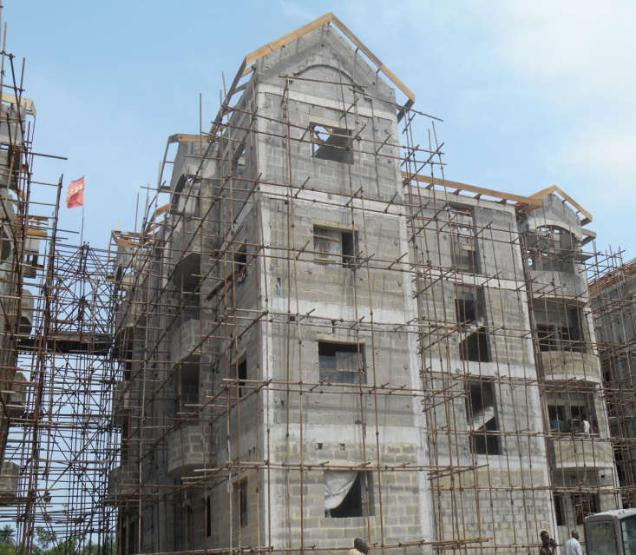
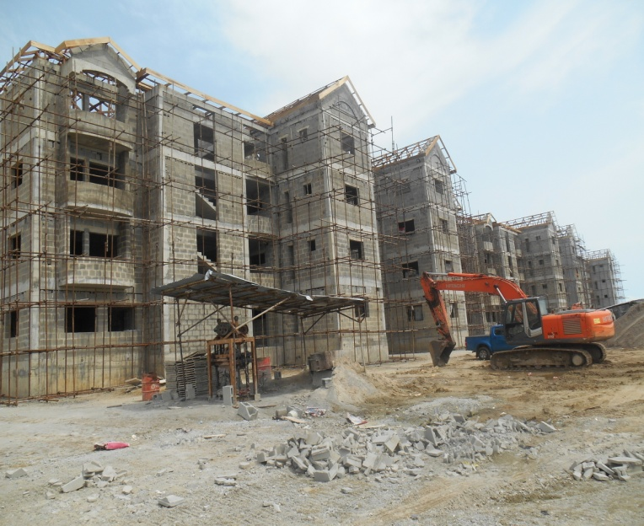
Annexures
Special Projects for Q1 Y2016: Construction of Blocks 50—54 Housing Units at Lagos Homs, Sangotedo [Phase 11]
64

Slide 65
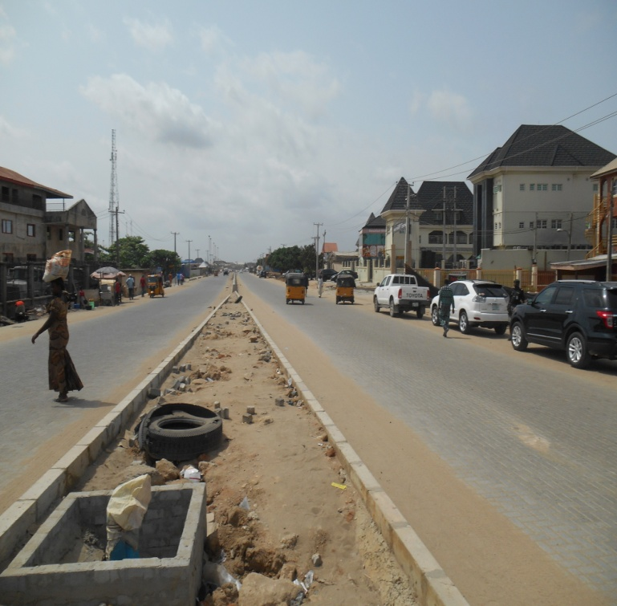
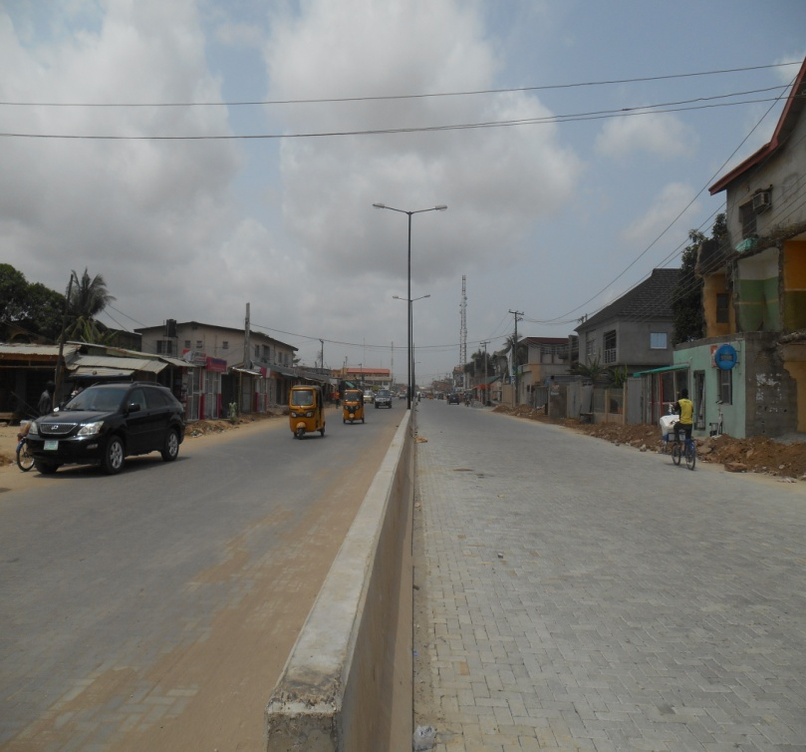
Annexures
Special Projects for Q2 Y2016: REHABILITATION OF AGO PALACE WAY [PHASE IV], OSHODI-ISOLO LGA
65

Slide 66
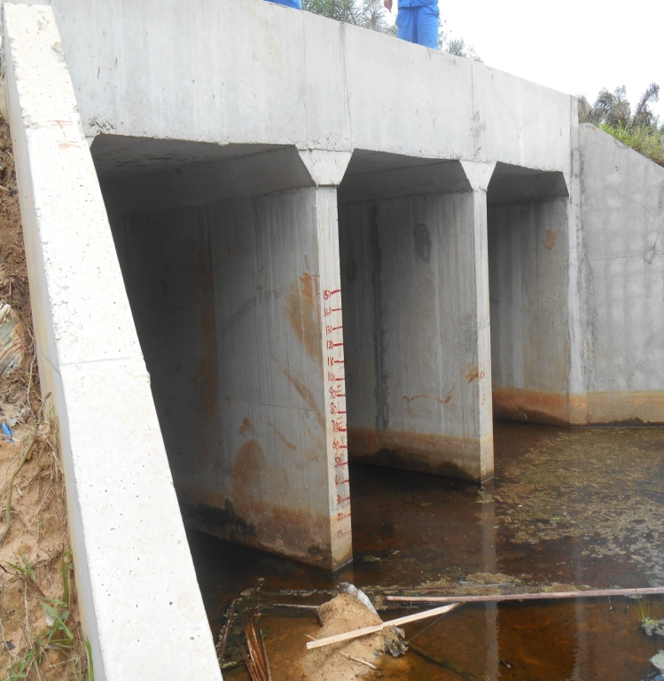
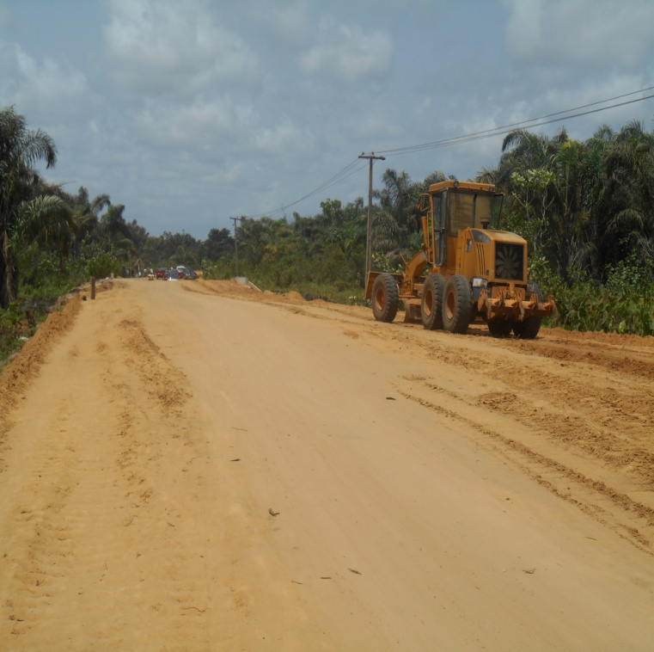
Annexures
Special Projects for Q2 Y2016: CONSTRUCTION OF AJARA-AGELASHO ROAD, BADAGRY LGA
66

Slide 67
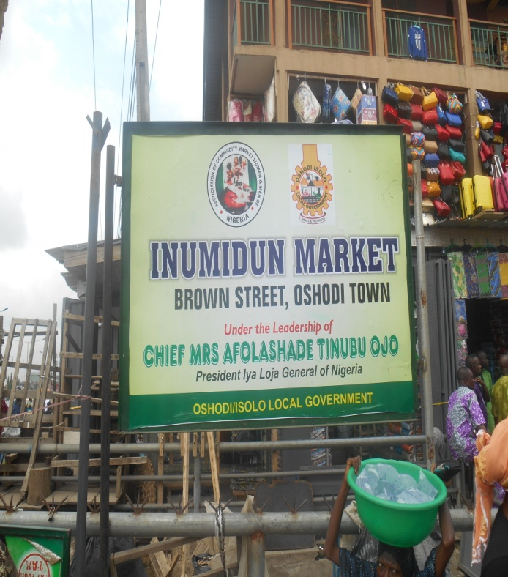
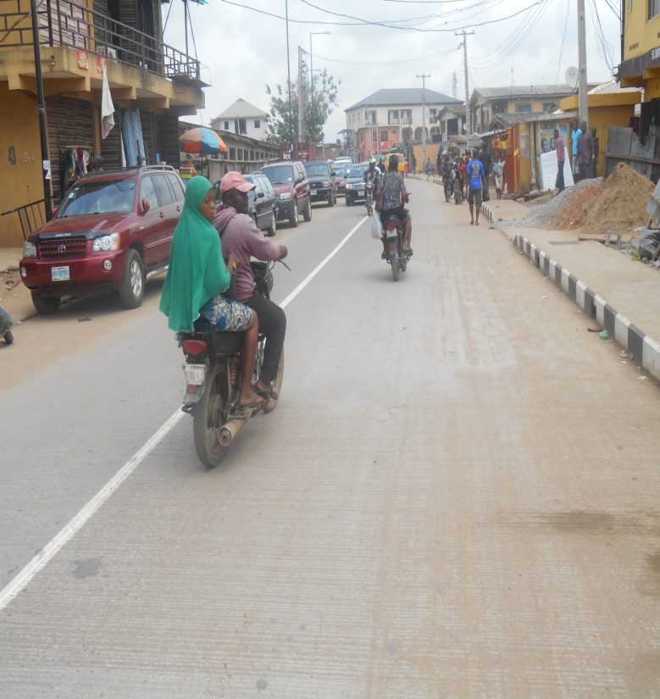
RECONSTRUCTION OF BROWN STREET, OSHODI, IN OSHODI LGA
67

Slide 68
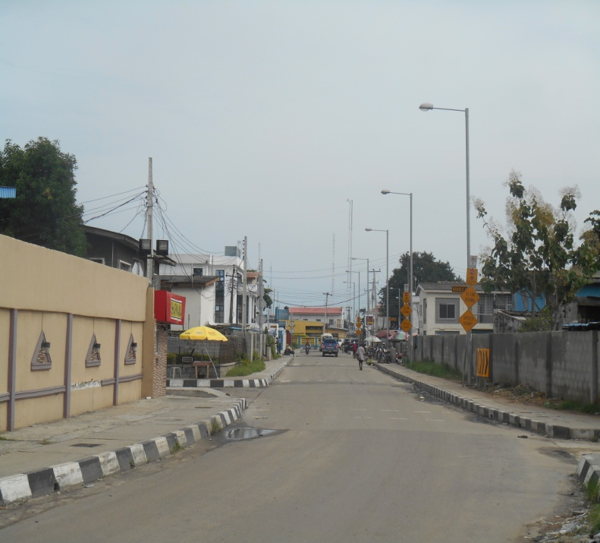
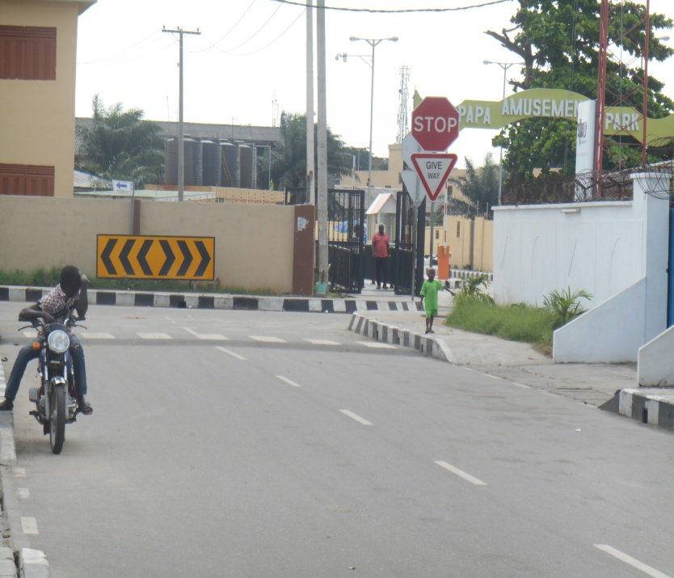
:Upgrading of Roads within Apapa Central Business District, Apapa LGA
68

Slide 69
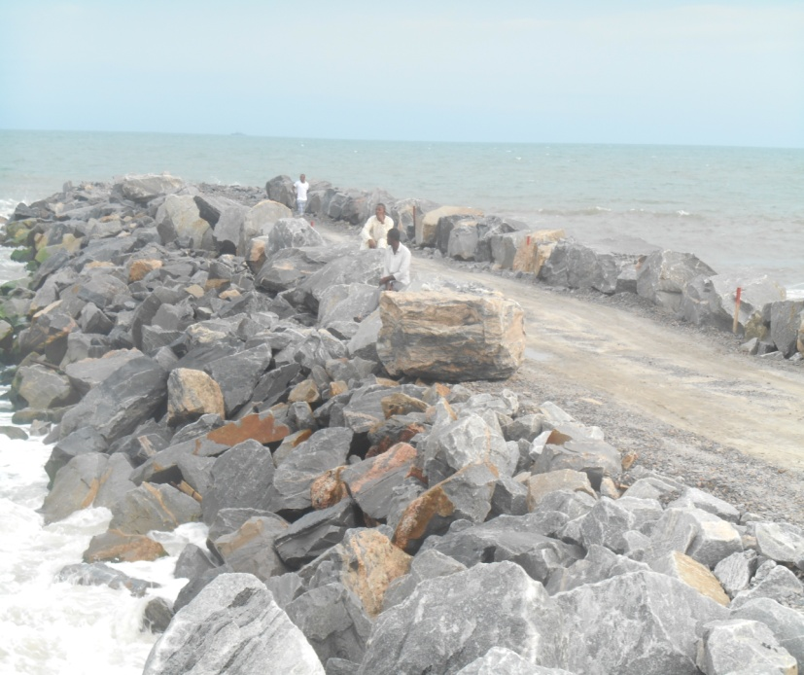
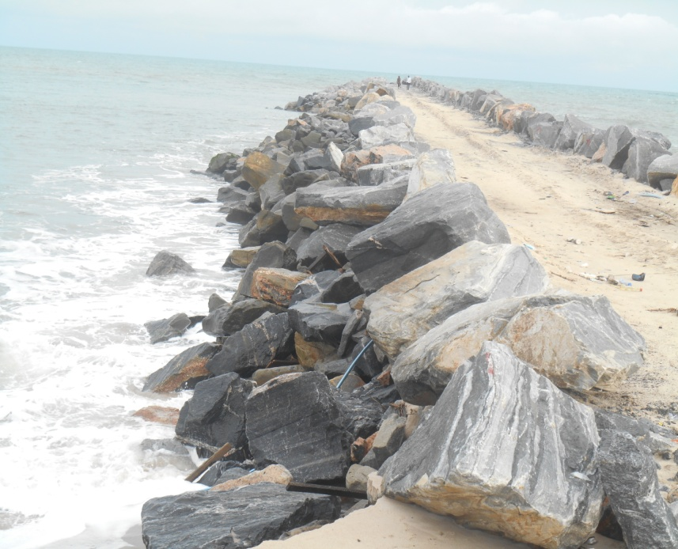
Phase ll of Holistic Solution to Lagos State Ocean Surge between Goshen Estates, Eti-Osa LGA

Slide 70
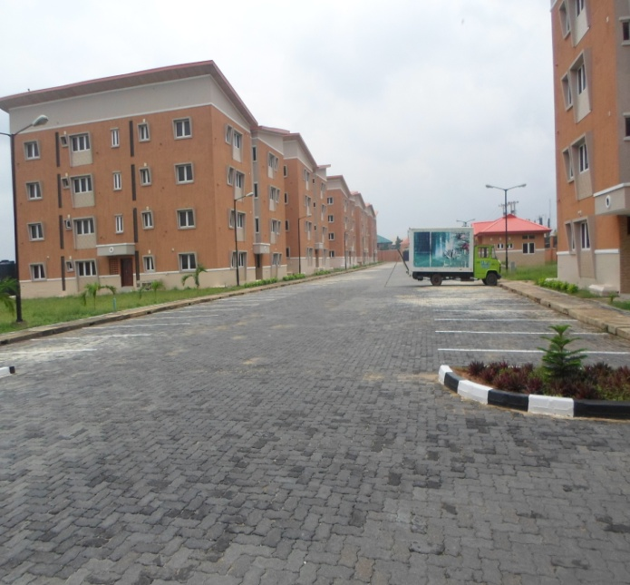
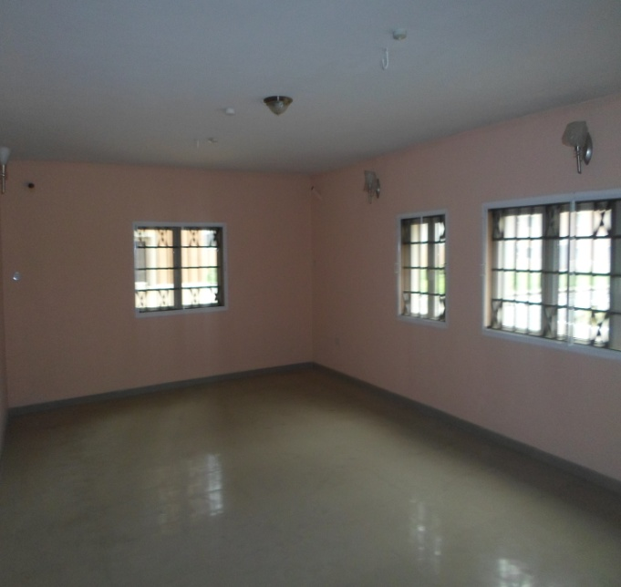
Development of 9 Blocks [108 units] of Lagos Homs at Oko-Oba, Agege LGA

Slide 71
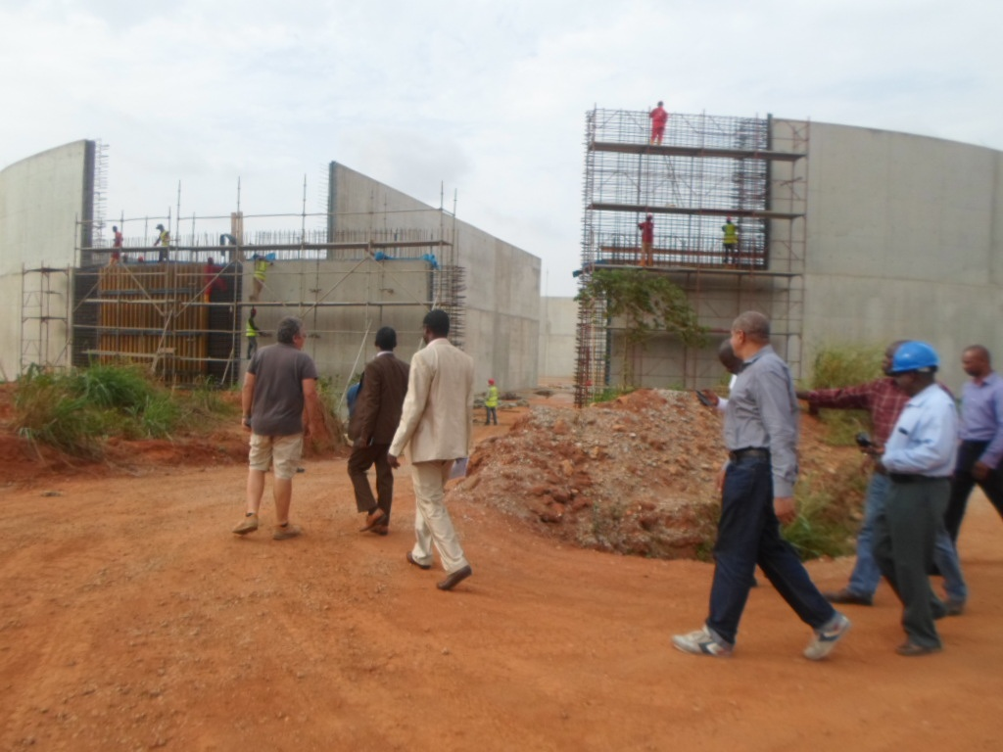
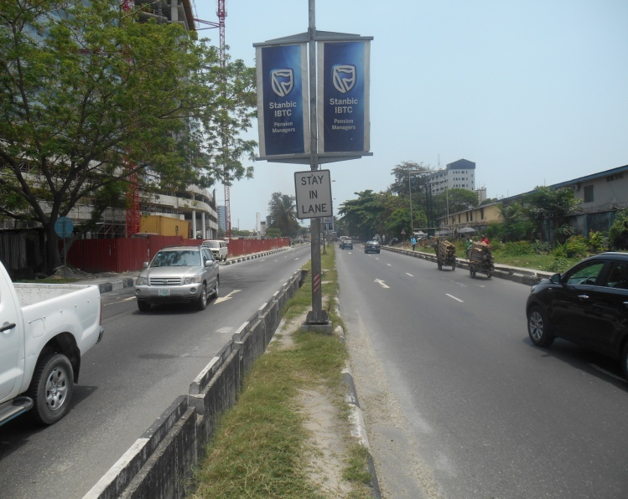
CONSTRUCTION OF ADIYAN WATER WORKS PHASE II
Reconstruction of Ozumba Mbadiwe Road, Victoria Island

